Slide 1
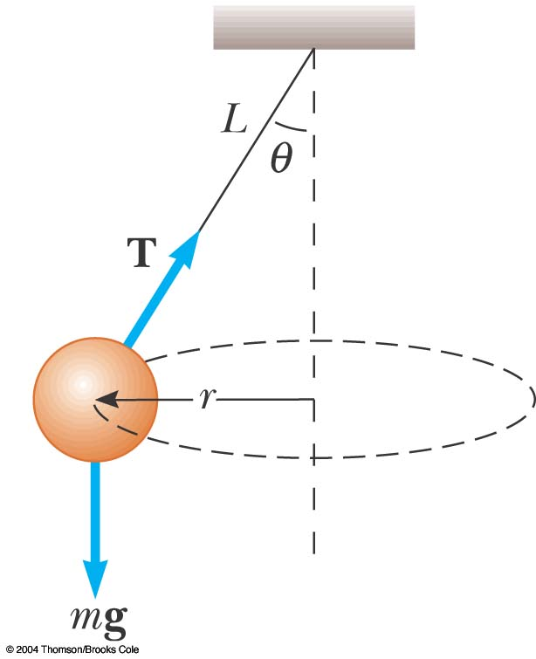
Pendulum
A string is attached to mass m and swung in a horizontal circle of radius r.
There is tension T in the string.
The angle θ is measured from the vertical (where the string is held).
On the free-body diagram there is no centripetal force indicated. It is not a separate force.

Slide 2
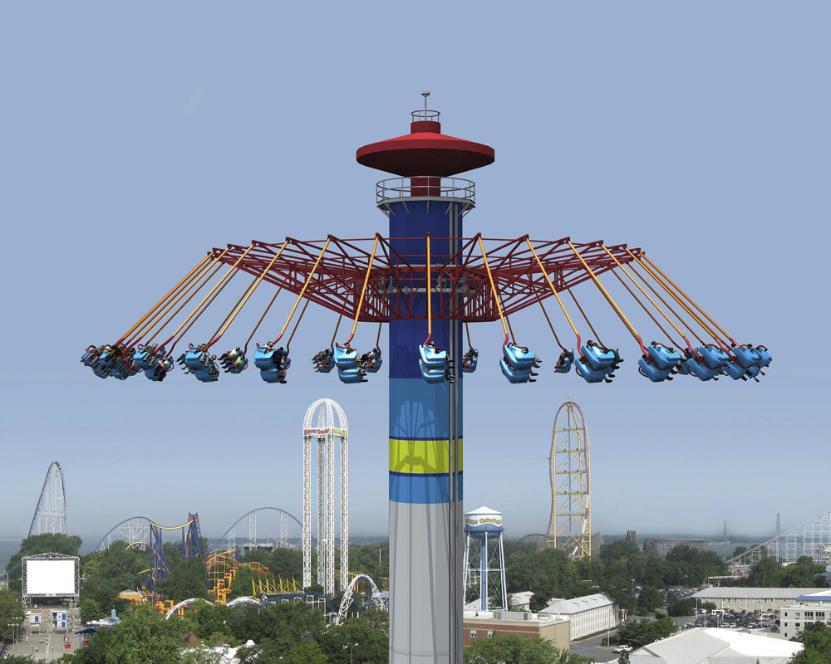

Slide 3
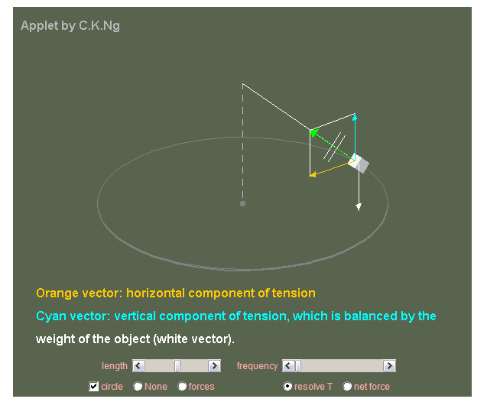
http://ngsir.netfirms.com/englishhtm/ConicalPendulum.htm

Slide 4
What is the Speed of a
Conical (horizontal) Pendulum?
θ
T
r
Can you derive …
mg

Slide 5
What is the Speed of a
Conical (horizontal) Pendulum?
θ
Easy method
T
θ
T
mg
r
ΣF_{c}
mg

Slide 6
What is the Speed of a
Conical Pendulum?
θ
T
r
mg

Slide 7
A pendulum bob with mass of 1.5 kg whirls around in a horizontal circle at constant speed v at the end of a 1.7 m cord. The cord makes a 37°angle with the vertical.
  What is the bob’s speed?
  How long does it take it to make one revolution?

Slide 8
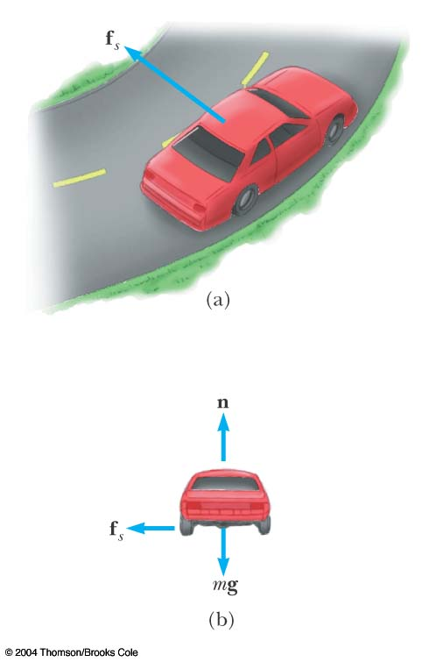
Flat Curve
Friction is keeping the mass on the curve and is acting towards the center.
The frictional force can be set equal to the centripetal force

Slide 9
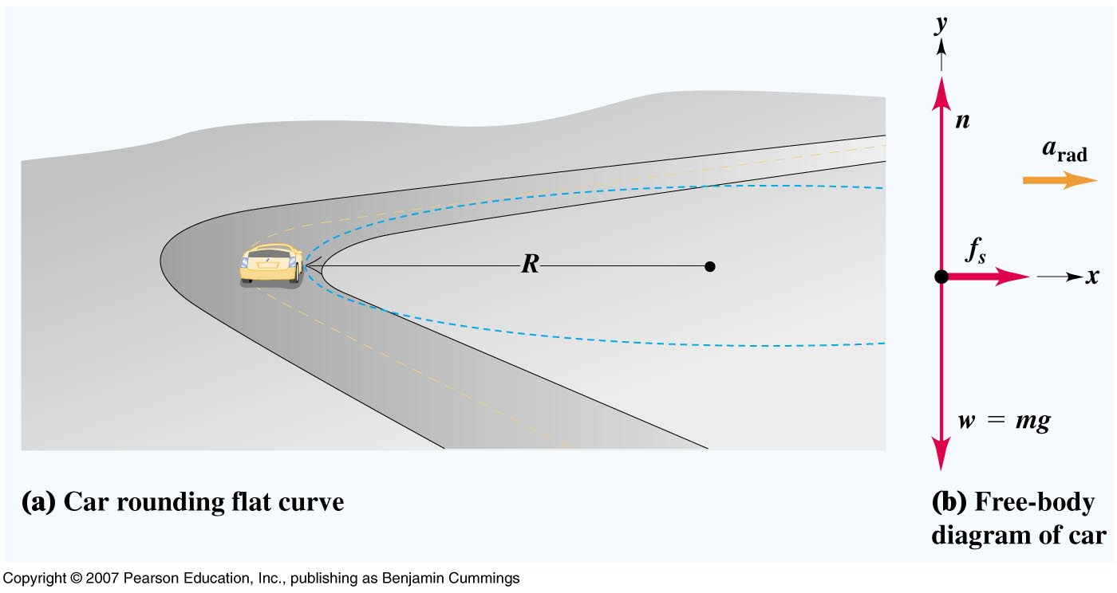

Slide 10
‘Banked’ Curves (Uniform) Circular Motion…
Can you derive …

Slide 11

Banked Curve?

Slide 12
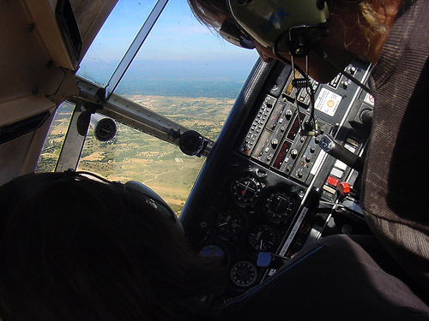

Slide 13
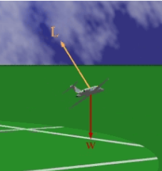

Slide 14
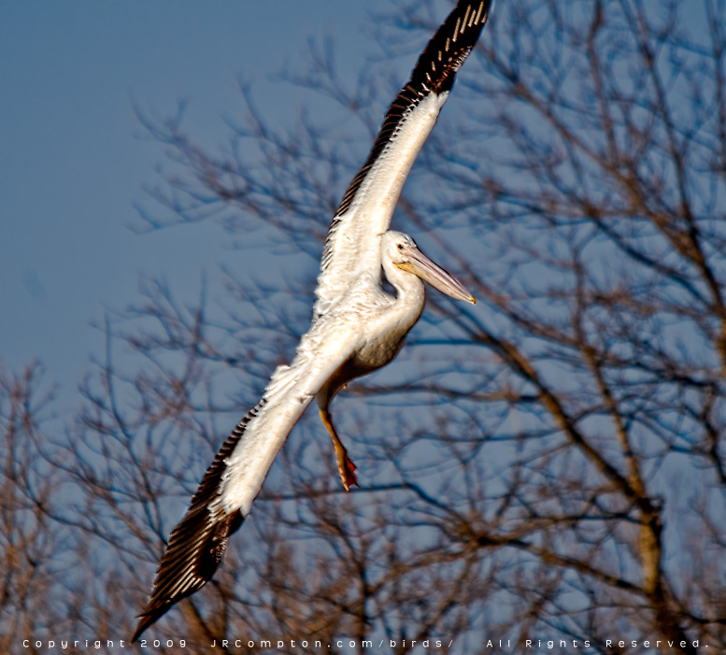

Slide 15
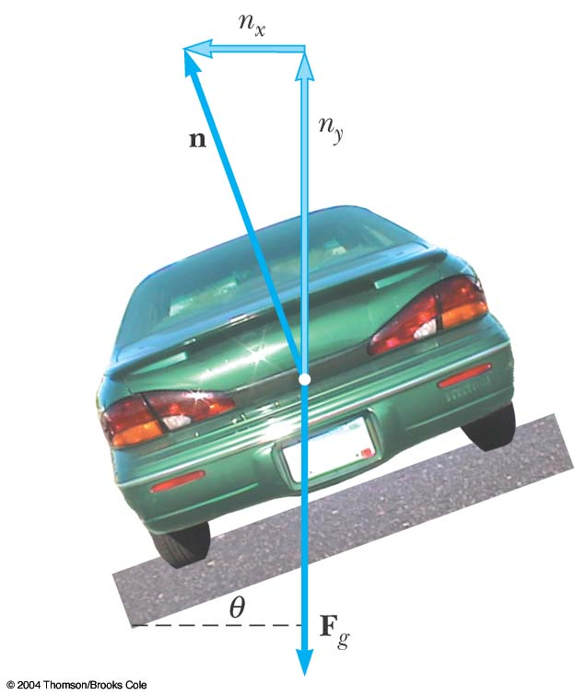
Banked Curve
A component of the Support / normal force is keeping the car on the curve. So the reliance on friction can be reduced with a banked curved.
The horizontal component of the Support / normal force can be set equal to the centripetal force. The vertical component of the normal force offsets the weight.

Slide 16
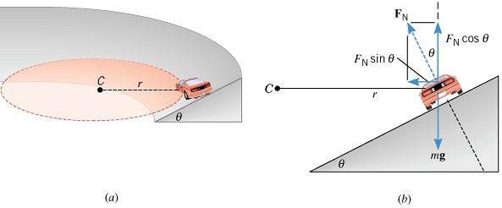
Can you derive …

Slide 17
A car of mass m is moving at a constant speed of 20 m/s around a banked curve with 200 m radius.
i) What angle is needed to make the reliance on tire friction unnecessary (or assume an extreme icy surface…) ?
ii) the radius of the curve was 40m?
11º
45º

Slide 18
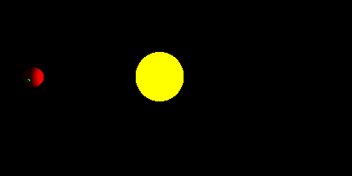
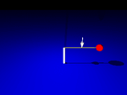
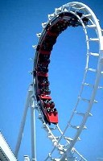
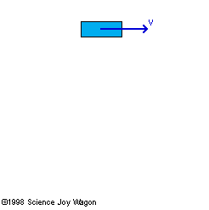
What type of force is providing the centripetal force in the following examples……
Ball on a string?
Earth orbiting the sun?
Moon orbiting the earth?
At the top of a roller coaster loop?
A car on a circular track?

Slide 19

Tension (T) – force applied by a string or rope
Ex:
5 N
T = 5 N
We say “the tension in the string is 5 N”
The tension force is directed along the length of the wire and pulls equally on the objects on the opposite ends of the wire
T
T

