Slide 1
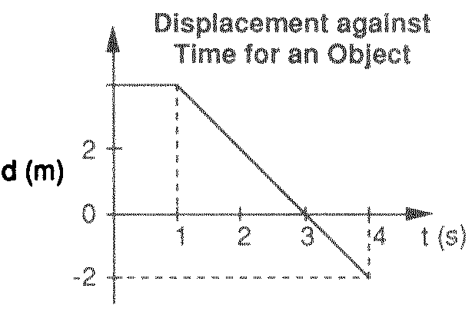
Displacement vs. Time Graphs
The slope of a displacement/time graph gives velocity.

Slide 2
Look at the cars – what do you notice about their movement?

Slide 3
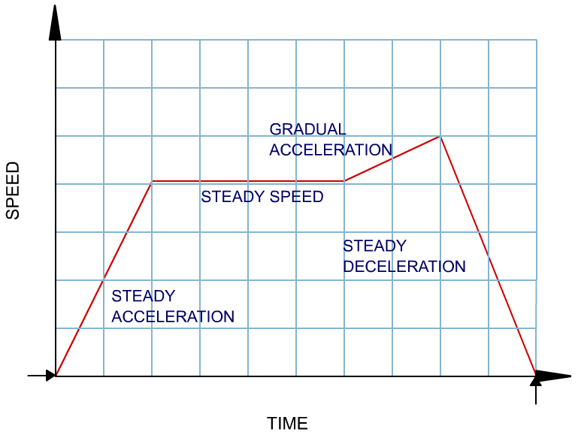
Velocity vs Time graphs
Acceleration is the gradient of a velocity vs time graph.
The displacement (distance travelled) is the area between the line (or curve) and the time axis.
Velocity

Slide 4
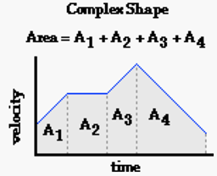

Slide 5
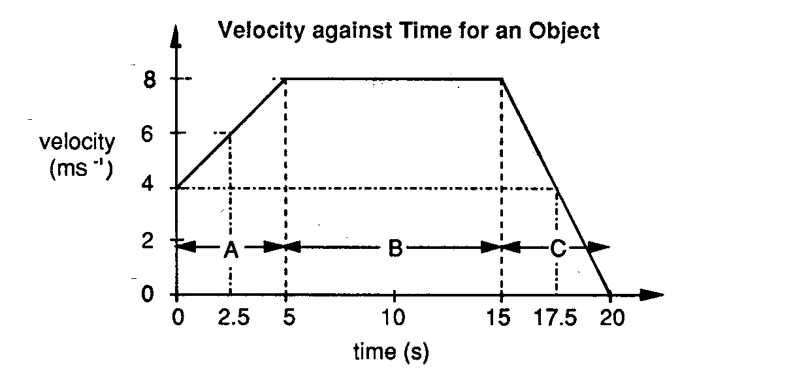
Analyse the object’s motion (d, v & a) in three sections: A, B, & C.

Slide 6
Discuss what the graphs are telling you about the relative movements of the cars? Link this to the motion recorder shown behind the cars.

Slide 7
Discuss what the graphs are telling you about the movement of the ball?

Slide 8
Graphing position(x), velocity(v), and acceleration(a)
Web Links: Graphing position, velocity & acceleration
Constant position, velocity & acceleration
Examples:
Ex 1)
Ex 2)
x
x
4m
2m
t
2s
t
v
v
?
?
t
t
a
a
?
?
t
t

Slide 9
Ex 3)
x
?
t
v
12 m/s
t
a
3 s
?
t
Web Link: More graphing position,velocity,acceleration
Notes:
“We know the shape of x(t), but how do we find the final position x here? Well, we need the constant acceleration equations…. -> “

Slide 10
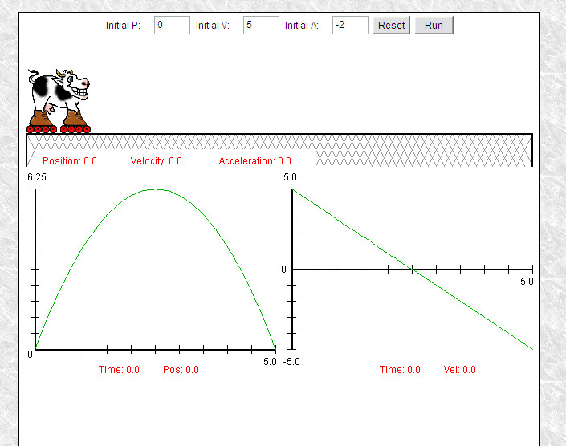
Cow on skates applet

