Slide 1
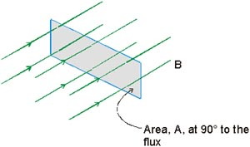
Magnetic flux [weber Wb], defines the amount of magnetic field (B [Tesla]) which travels perpendicular to an area A [m²]
Symbol: Ф
Unit: Weber Wb
A

Slide 2
Magnetic Flux
(symbol Φ)
Is a measure of the density of the magnetic field ~ ie count the amount of field lines within a given area. Compare with the density of a forest ~ the amount of trees (lines) in a given space
B
S
N
Magnetic Flux = Φ = B A
B = magnetic field
SI unit = 1 Weber = T·m²
A = surface area
Note also Φ = B A cosθ
This implies if the “area” rotates then the flux will change…
θ = angle between B and the Normal to the surface
ie max Φ when perpendicular

Slide 3
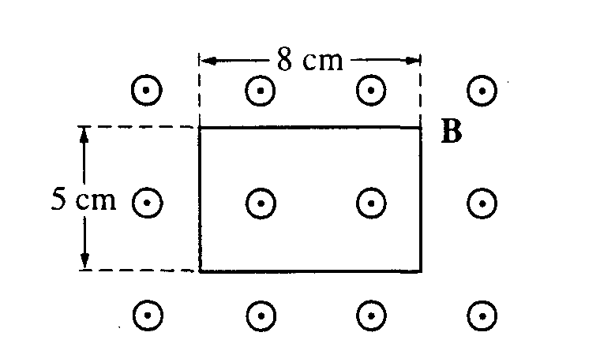
A rectangular wire loop is at rest in a uniform magnetic field B of magnitude 2 T that is directed out of the page. The loop measures 5 cm by 8 cm, and the plane of the loop is perpendicular to the field, as shown above. The total magnetic flux through the loop is
zero
2 x 10⁻³ T·m²
8 x 10⁻³ T·m²
2 x 10⁻¹ T·m²
8 x 10⁻¹ T·m²

Slide 4
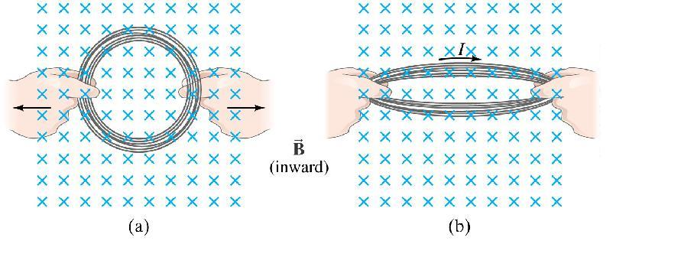
Magnetic flux will change if the area of the loop changes:
ΔΦ = Δ(BA) = B ΔA = A ΔB etc

Slide 5
Faraday’s Law
Rate of change of magnetic flux in a circuit
Induced voltage/ emf in a circuit
Induced
emf
Change
in Flux
Lenz’s
Law
Number
of Turns
Change
in Time
Lenz’s law determines the direction of current flow and accounts for the negative sign in Faraday’s Law.
The induced emf produces a current that opposes the change in magnetic flux (i.e. that tries to keep the flux constant or to compensate for the change in flux).

Slide 6
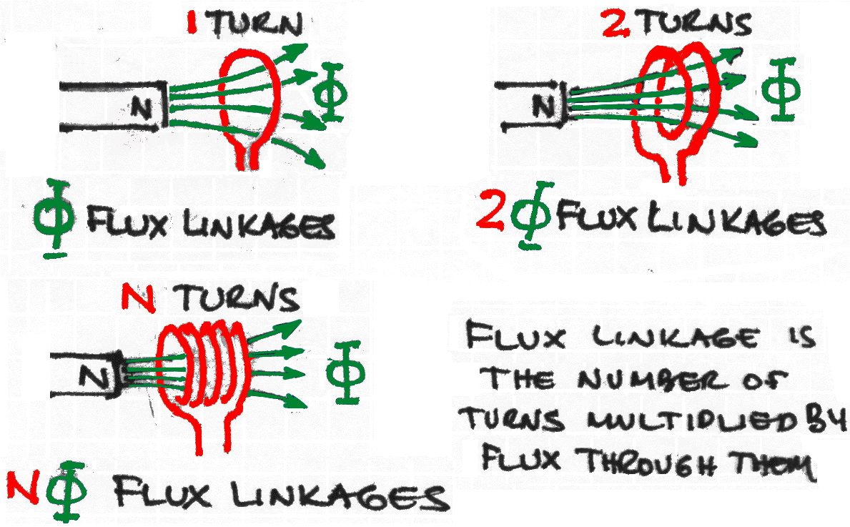
ΔΦ
ε
=
−
N
Δ
t
(N = number of turns)

Slide 7
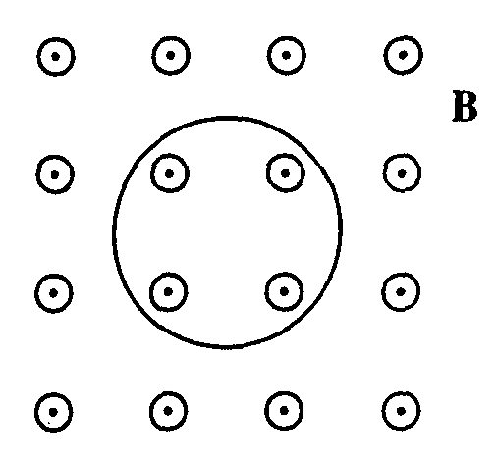
A single circular loop of wire in the plane of the page is perpendicular to a uniform magnetic field B directed out of the page, as shown above. If the magnitude of the magnetic field is decreasing, then the induced current in the wire is
directed upward out of the paper
directed downward into the paper
clockwise around the loop
counterclockwise around the loop
zero (no current is induced)
Lenz’s law to compensate for decreasing flux

Slide 8
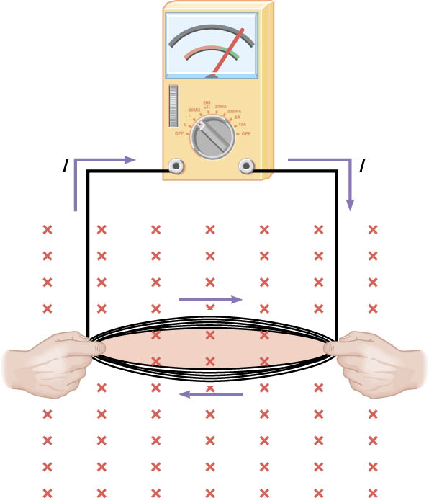
Problem
As the loop is pulled and its area is decreased, what is the direction of the current that is induced in it?

Slide 9
Magnetic flux in the loop increases
Counterclockwise

Slide 10
Magnetic flux in the loop increases
Clockwise

Slide 11
Magnetic flux in the loop decreases
Clockwise

Slide 12
Magnetic flux in the loop decreases
Counterclockwise

Slide 13
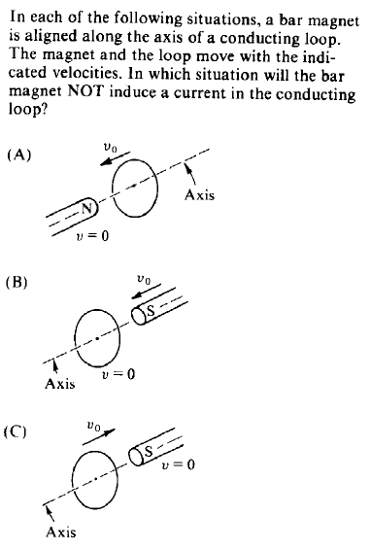
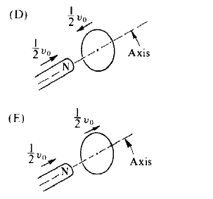
84 #53

Slide 14
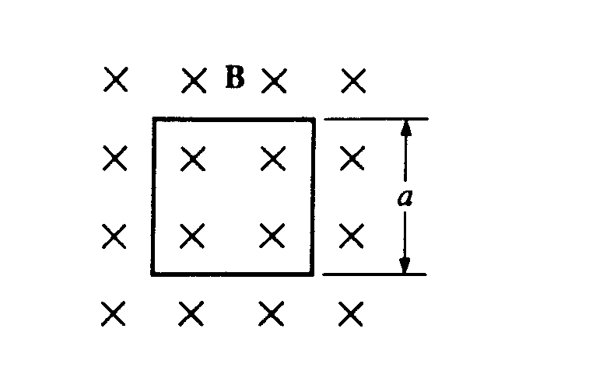
A square loop of wire of resistance R and side a is oriented with its plane perpendicular to a magnetic field B, as shown above. What must be the rate of change of the magnetic field in order to produce a current I in the loop?
(A) IR/a²
(B) la²/R
(C) la /R
(D) Ra/l
(E) IRa
Put Faradays law = Ohms law and solve for rate of B

Slide 15
20 cm
B = 2.0 T
x
x
x
x
x
x
x
x
20 cm
x
x
x
x
x
x
x
x
The wire loop has a resistance of 20 mΩ. If its area is reduced to zero in a time of .20 s, find the magnitude and direction of the induced current.

Slide 16
Lenz law
When the N pole is moved into the coil a current flows.
The direction of the current is such that it produces a field that opposes the change causing it.
The end of the coil nearest the magnet becomes N (direction from solenoid rule).
N
N
S
S
S
N
A
Work is done against this opposing magnetic field to produce electricity.
If this did not happen the law of conservation of energy would be broken (free energy!).
The induced current always flows in the direction that opposes the change causing it.
This effect is know as Lenz law.

Slide 17
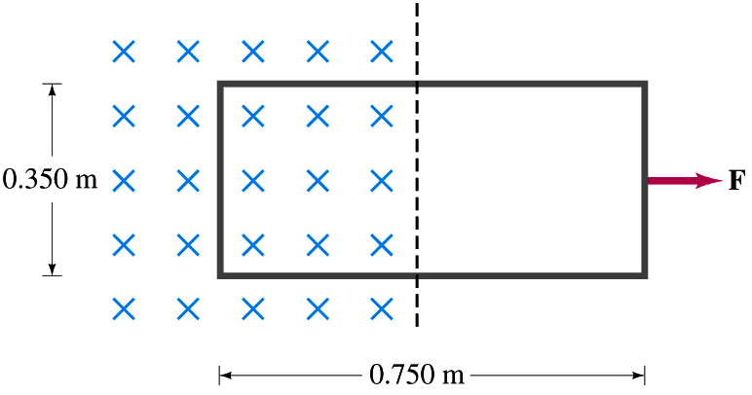
A single rectangular loop of wire with the dimensions shown is situated so that part is in a region of uniform magnetic field of 0.450 T and part is outside the field. The total resistance of the loop is 0.230 Ω.
a) Calculate the voltage induced in the loop as it is pulled out of the field (to the right) at a constant velocity of 3.40 m/s.
b) What is the magnitude and direction of the current flowing in the loop during this motion?
Use ε = BvL or ε=ΔΦ/Δt ?

Slide 18
Proof
Δt
B
At t = 0
v
L
Φ_{ο} = BA = BLx
After Δt
x
Δx
Φ = Φ_{o} + ΔΦ
Φ = BLx + BLΔx
ΔΦ = BLΔx
ΔΦ = BL(vΔt)

Slide 19
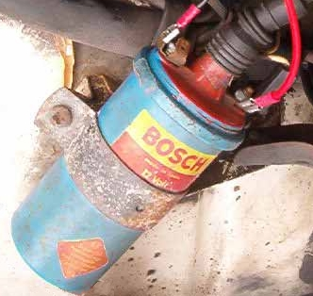
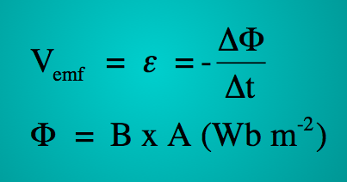
Electromagnetism: Car's ignition
The ignition coil in a car engine has many turns of wire and produces a very high voltage from a 12 V car battery.
Finding the emf in one loop of wire and then multiplying it by the number of turns will determine this high voltage.
This single loop of wire is immersed in a magnetic field.
The loop has a diameter of 5 cm
Show the area of the loop of wire is 0.002 m²
Å Å Å Å Å Å
Å Å Å Å Å Å
Å Å Å Å Å Å
Å Å Å Å Å Å
Å Å Å Å Å Å
Å Å Å Å Å Å
The strength of the magnetic field (B, flux density) is 0.08 T (0.08 Wb m⁻²)
Calculate the flux (φ) passing through the coil.
The current is switched off and the magnetic field collapses in 100 µs
Calculate the emf that is generated in the loop of wire whilst the magnetic field is reducing to zero.
Explain how to determine the direction of the induced current.

Slide 20
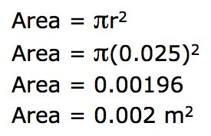
Electromagnetism: Car's ignition
Å Å Å Å Å Å
Å Å Å Å Å Å
Å Å Å Å Å Å
Å Å Å Å Å Å
Å Å Å Å Å Å
Å Å Å Å Å Å
The ignition coil in a car engine has many turns of wire and produces a very high voltage from a 12 V car battery.
Finding the emf in one loop of wire and then multiplying it by the number of turns will determine this high voltage.
This single loop of wire is immersed in a magnetic field.
The loop of wire has a diameter of 5 cm
Show the area of the loop of wire is 0.002 m²

Slide 21
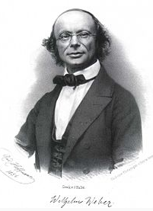
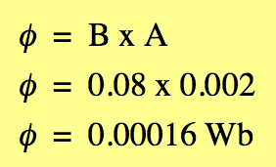
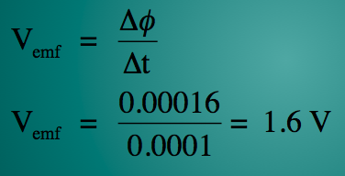
Electromagnetism: Car's ignition
Å Å Å Å Å Å
Å Å Å Å Å Å
Å Å Å Å Å Å
Å Å Å Å Å Å
Å Å Å Å Å Å
Å Å Å Å Å Å
The ignition coil in a car engine has many turns of wire and produces a very high voltage from a 12 V car battery.
This single loop of wire is immersed in a magnetic field.
The loop of wire has a diameter of 5 cm.
Calculate the flux passing through the loop of wire.
The current is switched off and the magnetic field collapses in 100 µs
Calculate the emf that is generated in the loop of wire whilst the magnetic field is reduced to zero.
If the coil had a 20,000 turns then the induced voltage would be 32,000 V
Wilhelm Eduard Weber
1804 - 1891

Slide 22
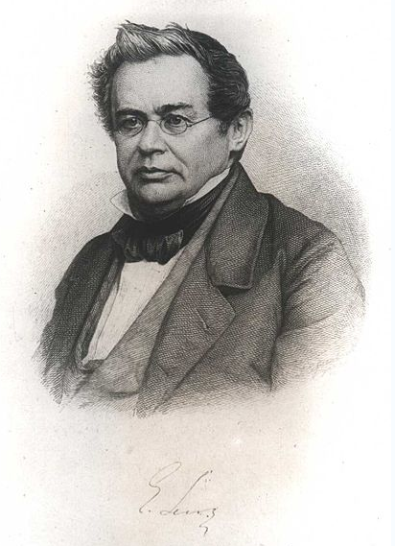
Electromagnetism: Car's ignition
The ignition coil in a car engine has many turns of wire and produces a very high voltage from a 12 V car battery.
Finding the emf in one loop of wire and then multiplying it by the number of turns will determine this high voltage.
Explain how to determine the direction of the current.
Lenz's law states that when an emf (voltage) is generated by a change in magnetic flux.
the induced emf is such that it produces a current whose magnetic field opposes the change which produces it.
The induced magnetic field inside any loop of wire always acts to keep the magnetic flux in the loop constant.
That is, the induced current tends to keep the original magnetic flux from changing.
Heinrich Friedrich Emil Lenz
1804 - 1865

Slide 23
Electromagnetism: Car's ignition
The ignition coil in a car engine has many turns of wire and produces a very high voltage from a 12 V car battery.
Finding the emf in one loop of wire and then multiplying it by the number of turns will determine this high voltage.
Explain how to determine the direction of the current, continued.
In 100 µs
Å Å Å Å Å Å
Å Å Å Å Å Å
Å Å Å Å Å Å
Å Å Å Å Å Å
Å Å Å Å Å Å
Å Å Å Å Å Å
N
N
S
S
Merit
Using the 'right-hand grasp rule' grasp the coil so that your thumb is pointing in the same direction as the generated magnetic field.
The direction of your fingers gives the direction of the current.
The direction of the induced current is anticlockwise.

Slide 24
Electromagnetism: Car's ignition
The ignition coil in a car engine has many turns of wire and produces a very high voltage from a 12 V car battery.
Finding the emf in one loop of wire and then multiplying it by the number of turns will determine this high voltage.
Explain how to determine the direction of the current, continued.
In 100 µs
Å Å Å Å Å Å
Å Å Å Å Å Å
Å Å Å Å Å Å
Å Å Å Å Å Å
Å Å Å Å Å Å
Å Å Å Å Å Å
N
N
S
S
Lenz's law states that an emf (voltage) is generated by a change in magnetic flux (φ),
the induced emf (V_{emf}) is such that it produces a current
the current that is produced has a magnetic field that opposes the change which produces it.
The induced magnetic field (B) inside the loop of wire always acts to try and keep the magnetic flux (φ) in the loop constant.
The induced current's magnetic field tends to keep the original magnetic flux from changing.

