Slide 1
Electricity Models

Slide 2
Backpacker model
Electrons are not created by the battery. Free electrons are there in the metal wires. The battery (Voltage) gives them energy that they loose while travelling in the circuit transformed into light and heat by the light bulb and heat by the resistor.
X

Slide 3
Boiler/ pump
radiator

Slide 4
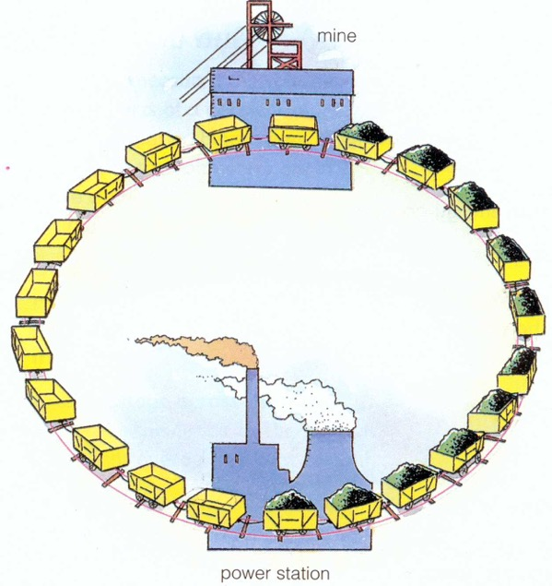

Slide 5
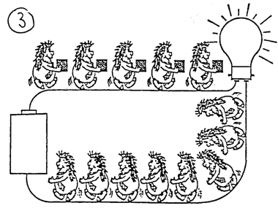
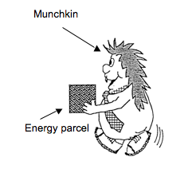
Munchkins model
Describe 5 key aspects / components in the model…

Slide 6
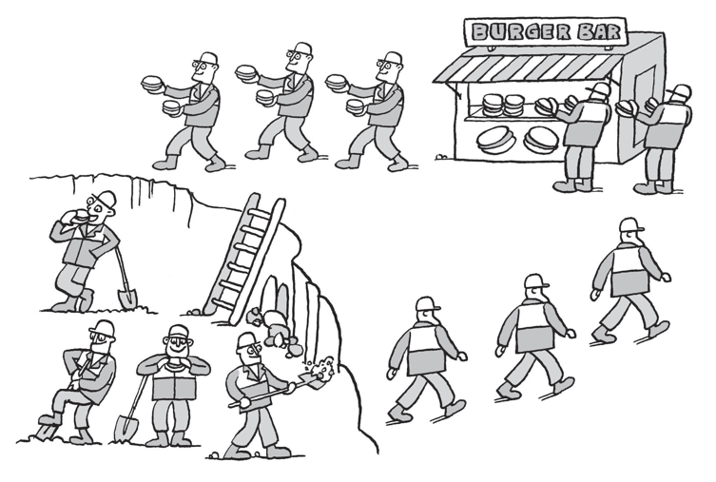
Burger Bar model
Describe 5 key aspects / components in the model…
The workers have diaries and plan their day (circuit) well…

Slide 7
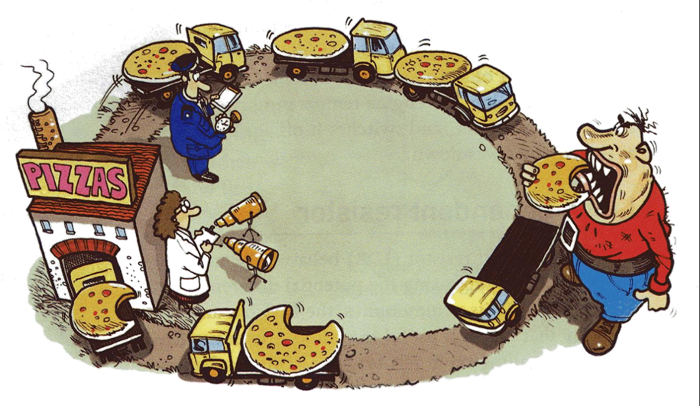
Pizza Monster model
Describe 5 key aspects / components in the model…

Slide 8
Models like this are great to analyse their limitations compared with real circuits
eg "what if the road had two lanes, what if the monster was less hungry, what if the road split, what if there was another factory", etc...
Pizza=energy
Trucks=charges
Road=conductor
Pizza factory=cell
Pizza monster=component (but leaves pizza on the trucks for other pizza monsters in the circuit)
Woman in white coat measuring pd = voltmeter
Traffic warden= ammeter (not really what traffic wardens do but ...)
Note: pizza and "pizza difference" is also pd!

Slide 9
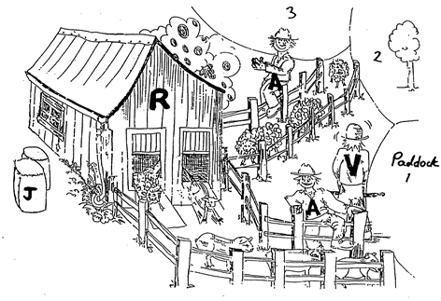
Farming model
Describe 5 key aspects / components in the model…

Slide 10
The Water Pump model
The Heart model (very similar to water pump, but another example that there are branched networks, and none of the blood is used up)
The Runway Model model (really just "the students walking around the class and stepping up and over a chair, or two in series, or two in parallel" model)
The Bottle of V being handed around the students in a circle model (some of the V gets poured out for each student/component, and the bottle has to come back empty)
The Trampers walking through the bush and needing to cross a swing bridge model - two swing bridges side by side reduces the total resistance
And then there's the demonstration model of a marble rolling down a ramp with a whole heap of nails in it to act as resistance - very cool
And finally, the passing around pieces of scrunched up paper model - each student is the atom (positive ion) that stays fixed, and the electrons get taken from one student and handed to the next. Each student must have one (or two) pieces of paper at all times

Slide 11
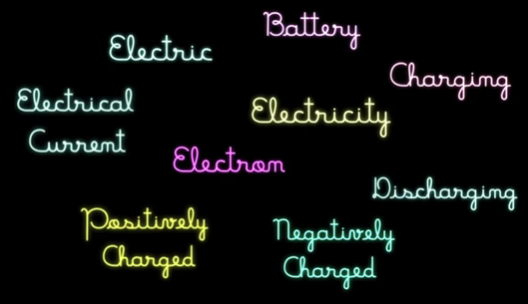
Electric Vocabulary - YouTube
Do you understand these terms?
Where did they come from – who coined them…?

