Slide 1
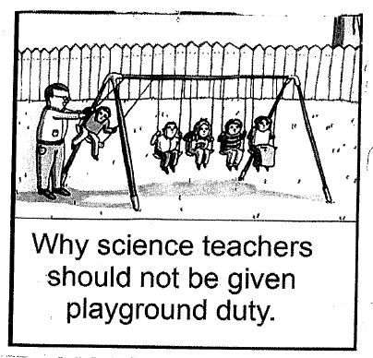

Slide 2
Conservation of Momentum
A system is a pair or group of objects that are interacting in some way.
If a system has no external forces acting on it (eg no friction), then the system is isolated. Total momentum in an isolated system is said to be conserved.

Slide 3
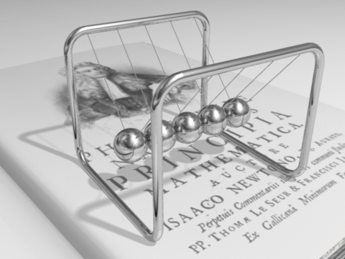

Slide 4
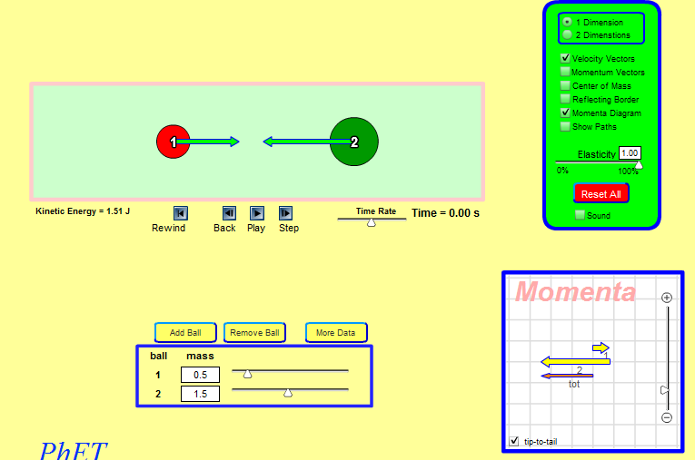
PhET Collision-lab

Slide 5
A car and its driver have a combined mass of 1200 kg.
The car collided with a stationary van of mass 1500 kg.
The car and van locked together after impact and from the marks on the road the police were able to deduce that the wreckage moved at 4.0 m s^{–1} immediately after the collision.
Calculate the speed of the car just before it collided with the van.

Slide 6
A car and its driver have a combined mass of 1200 kg.
The car collided with a stationary van of mass 1500 kg.
The car and van locked together after impact and from the marks on the road the police were able to deduce that the wreckage moved at 4.0 m s^{–1} immediately after the collision.
State what physical quantity is conserved in the collision.
State the condition necessary for the quantity you have named in (1) to be conserved

Slide 7
Imagine two cars on the road.
They have the same mass.
They collide head on at the same speeds.
Mass 1200kg v_{i} 15ms⁻¹
Mass 1200kg v_{i} -15ms⁻¹
Momentum = mass x velocity
P = mv
P₁ = m₁v₁
P₂ = m₂v₂
P₁ = 1200x15 kgms⁻¹
P₂ = 1200x(-15) kgms⁻¹
P₁ = 18000 kgms⁻¹
P₂ = -18000 kgms⁻¹
Velocity is a vector. Momentum is also. It has a direction.
So here the cars collide. The momentum adds to zero. The cars have no momentum therefore the crumpled wreckage is at a standstill.

Slide 8
Imagine two cars on the road.
They have the same mass.
One is stopped with the brake off.
The other slams into the back of the first and they lock together.....
m₁ 1200kg v₁ 0ms⁻¹
m₂ 1200kg v₂ 20ms⁻¹
Momentum = mass x velocity
P = mv
P₁ = m₁v₁
P₂ = m₂v₂
P₁ = 0 kgms⁻¹
P₂ = 1200x20 kgms⁻¹
P₂ = 24000 kgms⁻¹
So how fast does the wreckage move?
Momentum is conserved so that…
P_{initial}=
P_{final}
P_{f} = 24000kgms⁻¹
= m x v_{f}
24000 = (1200+1200) x v_{f}
v_{f} = 10ms⁻¹

