Slide 1
Centre of Mass ~ CoM
or
Centre of Gravity

Slide 2
New Zealand immigration website:
The 'centre of gravity' of your family is in New Zealand if:
The principal applicant has no dependent children and the number of their adult children lawfully and permanently in New Zealand is equal to or greater than those lawfully and permanently in any other single country…
“This is the centre of gravity for terrorism in the country.”
Major General Athar Abbas (speaking of South Waziristan in Pakistan, during heavy fighting there between the army and the Taliban)
“Comedy's new centre of gravity
Seth Rogen is box office gold thanks to two summer hits: Knocked Up and Superbad.”
Notes:
The phrase ‘centre of gravity’ is widely used outside science. Here are some examples.

Slide 3
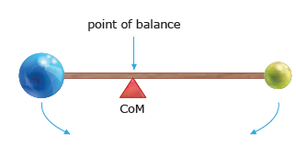
Centre of Mass ~ CoM
This is a point on an object where the total mass acts as if it is concentrated.
Also know as the centre of gravity ~ where the weight force acts on an object

Slide 4
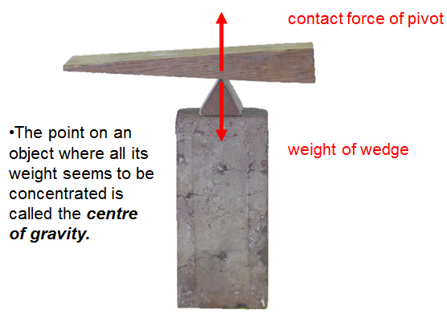

Slide 5
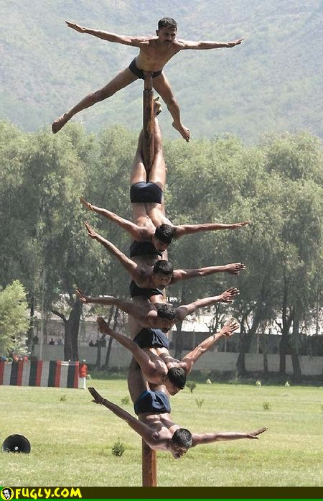

Slide 6
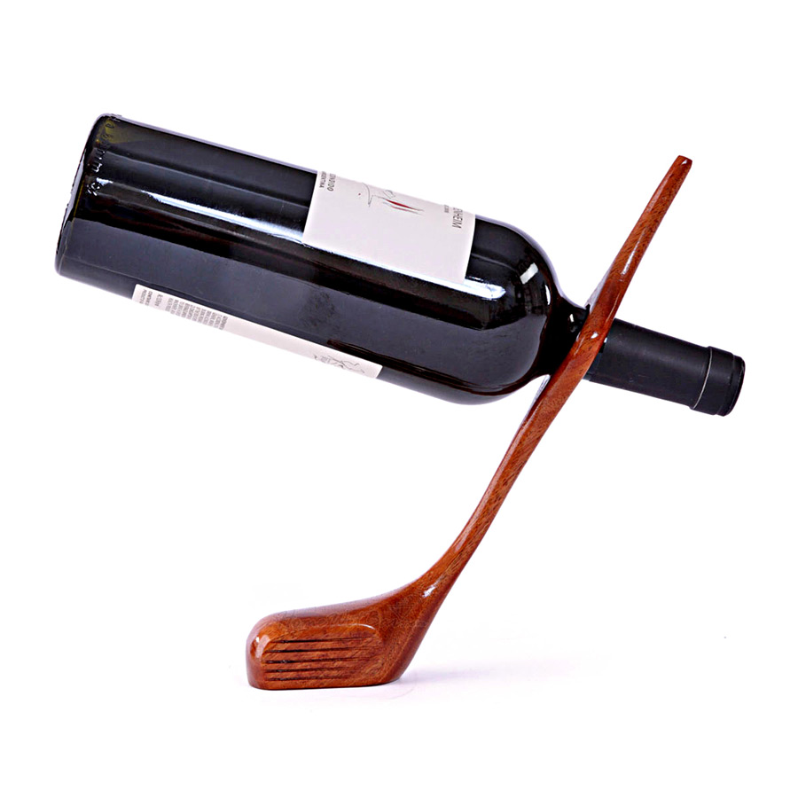

Slide 7
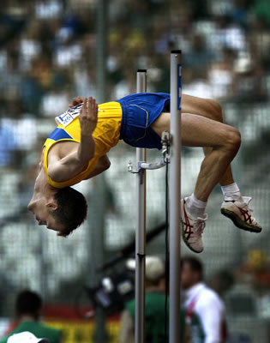
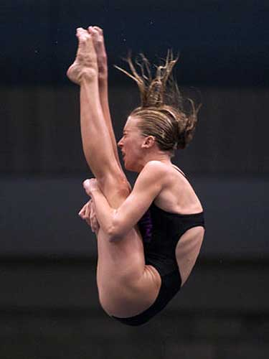

Slide 8
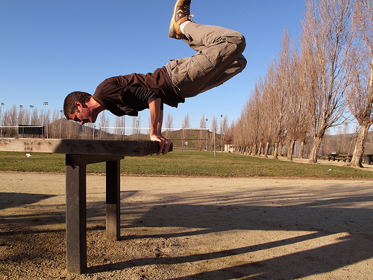
SPOT THE Centre of Gravity
What if he straightened his legs?
That would move his centre of gravity to the right, and he would unbalance, tipping clockwise.
Notes:
NOTE: before this activity, introduce the idea of centre of gravity/mass in whatever way you like: students try balancing objects (e.g. rulers with plasticine blobs stuck on, cardboard shapes) on their fingertips to find out Title slide. Assuming this man is in stationary balance, his centre of gravity must be above his base (his hands). What if he straightened his legs? That would move his centre of gravity to the right, and he would unbalance, tipping clockwise.

Slide 9
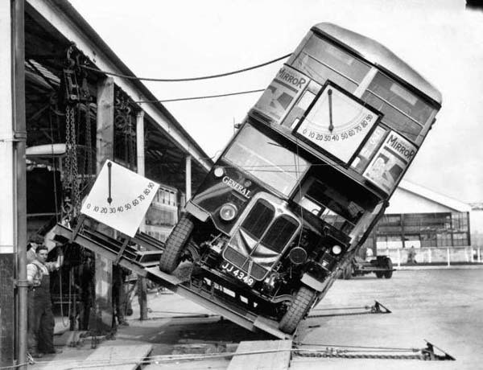

Slide 10
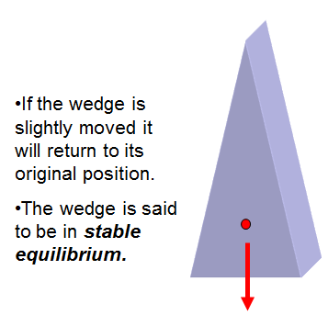
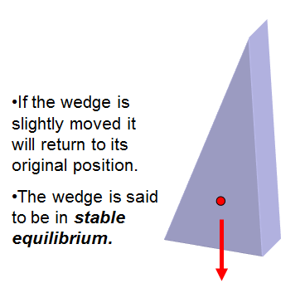
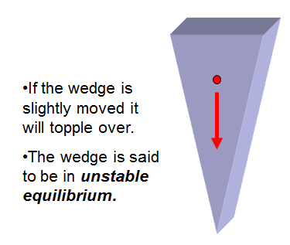
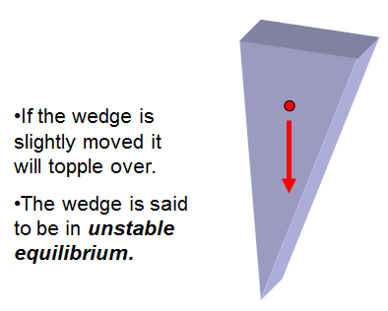

Slide 11
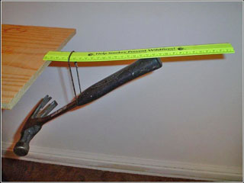
Why does this balance? The weight of the hammer is acting at a point directly below where the ruler overlaps the table.
Notes:
Starter option 2. Show this picture, or better, do the demo (or one of any number of fairly well-known similar ones, e.g. forks in cork). Why does this balance? The weight of the hammer is acting at a point directly below where the ruler overlaps the table.

Slide 12
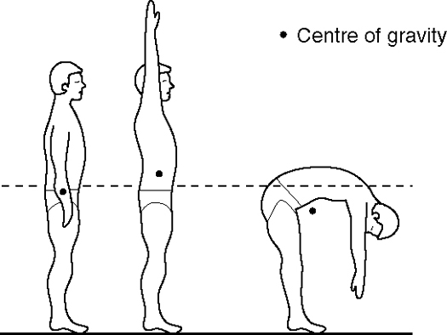
it is possible for an object’s centre of gravity to be outside the object.
Notes:
Some examples of how the location of a person’s centre of gravity can change. The picture on the right shows that it is possible for an object’s centre of gravity to be outside the object.

Slide 13
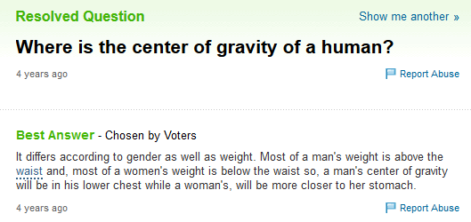
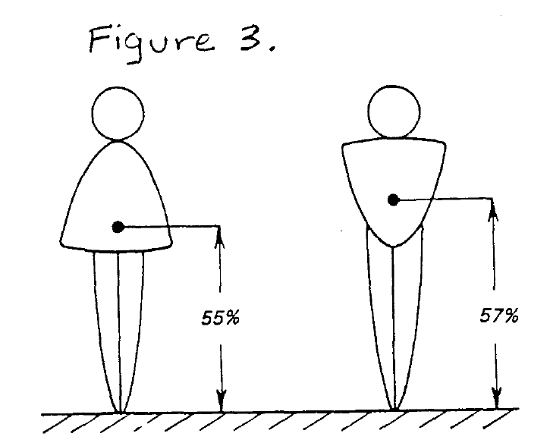

Slide 14
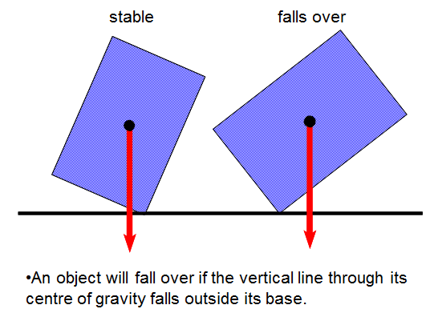

Slide 15
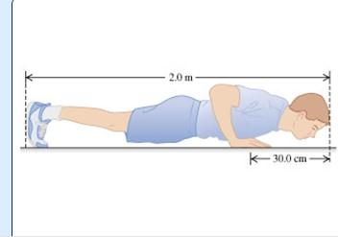
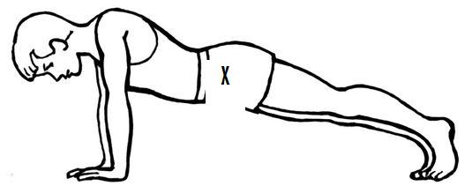
How to find Human centre of gravity / Mass??
Do a ‘Measured press – up’ to determine your CoM…

Slide 16
Torque ~ Turning Force e.g. the force used to open a door
d
F
ΣF = 0
Στ = 0
Conditions for Equilibrium
the total of all the clockwise torques
the total of all the anti- clockwise torques
=

Slide 17
A massless
meter stick
F_{s} = ?
What is the
Distance x₂
x₃ =
20 cm
x₂ = ?
p
1st Condition
of Equilibrium
2nd Condition
of Equilibrium
3 kg
2 kg

Slide 18
System ~ a group of objects
A single object has a CoM, systems also have a CoM
Calculating the position of the Center of Mass
assume Στ = 0

Slide 19
Calculate the position of the centre of mass (c.o.m) between the Earth and the Moon.
Compare your answer with the Earth's radius.
Radius of the Earth = 6.38 x 10⁶ m Mass of the Earth (M₁) = 5.97 x 10²⁴ kg Radius of the Moon = 1.74 x 10⁶ m Mass of the Moon (m₂) = 7.35 x 10²² kg Distance between the centre of the Earth and the centre of the moon = 3.84 x 10⁸ m

Slide 20
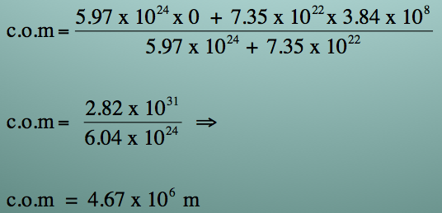
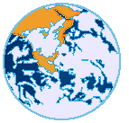
Calculate the position of the centre of mass between the Earth and the Moon.
Radius of the Earth = 6.38 x 10⁶ m
Mass of the Earth (M₁) = 5.97 x 10²⁴ kg
Radius of the Moon = 1.74 x 10⁶ m
Mass of the Moon (m₂) = 7.35 x 10²² kg
Distance between the centre of the Earth and
the centre of the moon = 3.84 x 10⁸ m
Taking the centre of the Earth as the reference point, i.e., x₁ = 0
2. Comparing this distance with the radius of the Earth. The c.o.m is roughly 2/3 from the centre of the Earth i.e. inside the Earth.
correct sig. fig (3).
A
correct answer
d
Moon
Earth

