Slide 1
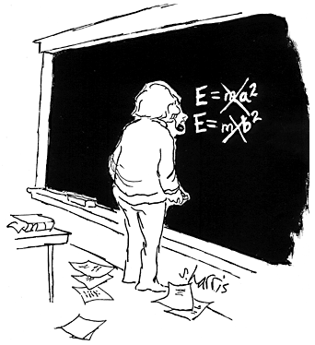
Nucleus (or nuclei) ~ center bit of the atom
Nucleons ~ protons & neutrons (bits inside the nucleus)
Z – Atomic # (p’s)
A – Mass # (p’s & n’s)
Mass is a form of energy related by
In nuclear reactions
mass – energy is conserved

Slide 2
Balancing Nuclear Equations
The Atomic number and Atomic mass are conserved. That means they have to add up to the same number on both sides of the equation.

Slide 3
Why have 2 different atoms got the same atomic mass?
Atomic number and Atomic mass are conserved BUT mass is not

Slide 4
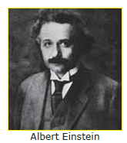
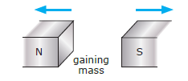

Slide 5
See Atomic scales Mass – energy applet

Slide 6
Mass Deficit & Binding Energy
In order to break up a nucleus into separate nucleons, you must overcome a strong but short range ‘Nuclear Force’ that binds / attracts the nucleons together.
You need to provide energy to overcome this force.
The energy required to separate / break up the nucleus is referred to as the binding energy and corresponds to the mass deficit
This explains why the mass of the individual nucleons is heavier.

Slide 7
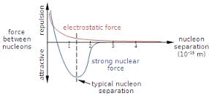

Slide 8
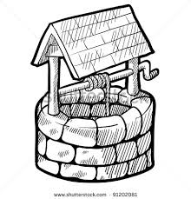

Slide 9
Just like energy is needed to pull a bucket of water out of a well against gravity…
…energy is also required to “pull” nucleons out of a nucleus.
i.e. energy is needed to break apart a nucleus.
➔Binding Energy

Slide 10
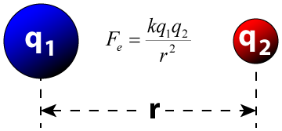
What’s going on inside the nucleus?
The nucleus is held together by a very short-range attractive force (the Nuclear Force) that exist between nucleons.
This force is greater than the long range repulsive Electrostatic (Coulomb) force that exist between all the positive protons in the nucleus.
Nuclear force similar to "Velcro,“ i.e. only acts as a force if in close proximity (less than 10⁻¹⁰ m).
Nuclides with large numbers of protons need more neutrons (which only exert the attractive strong nuclear force) to overcome the electric repulsion between protons. For these very large nuclei, ‘extra’ number of neutrons can overcome the electric repulsion between protons.
Elements with Atomic numbers greater then 82 (Lead) are basically too big (wide) the electrostatic forces are too much for the Nuclear force and the element will under go Radioactive decay (via α, β and or ∝).

Slide 11
Fiddly bits!
What are eV (electron volts) and its units ?
Is a small energy unit, used in atomic and nuclear processes.
1 eV = 1.6 x10⁻¹⁹J
1 MeV = 1.6 x10⁻¹³J
Is the energy given to an electron by accelerating it through 1 volt of electric potential difference…
More on this later…
What is an amu ?
is the standard unit that is used for indicating mass on an atomic scale. It is defined as one twelfth of the mass of an unbound neutral atom of carbon-12
1 atomic mass unit (amu) = 1.661 x 10⁻²⁷ kg
1 amu = 931.3 MeV (E =mc²) mass – energy equivalence!

Slide 12
Binding Energy per nucleon
Binding energy per nucleon = binding energy of nucleus / # of nucleons
The stability of a nucleus depends not so much on the total binding energy of the atom but due to the atom’s binding energy per nucleon.
Greater the binding energy per nucleon, the more stable the nucleus (ie Fe).
B.E per nucleon
(MeV)
⁵⁶Fe
8
²³⁸U
⁴He
6
⁷Li
4
2
Mass number
50
100
150
200

Slide 14
