Slide 1
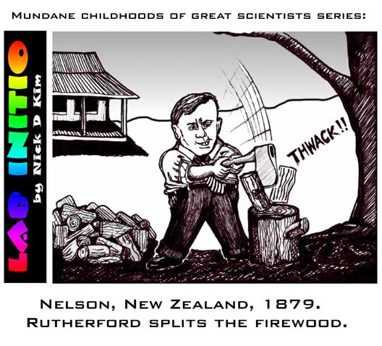

Slide 2
History of the
Development of
Atomic Models
From Ancient Greeks to nowadays…
(all but Thompson & Rutherford are optional info but good to know)

Slide 3
Models are often used for things that are too small or too large to be observed or that are too difficult to be understood easily

Slide 4
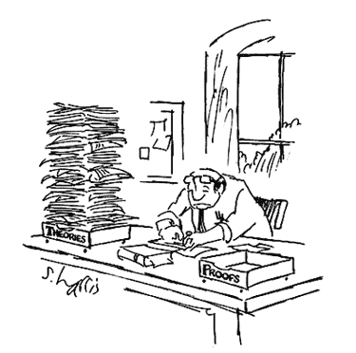
In the case of atoms, scientists use large models to explain something that is very small.
Models of the atom were used to explain data or facts that were gathered experimentally.
Models are only theories until they are experimental tested.

Slide 5
Early Models:
Greeks - Matter is made up of four basic ‘elements’ – air, earth, fire, water
Dalton – All matter is made up of atoms, atoms are:
Indivisible, the building blocks of matter
Indestructible, tiny –the smallest unit of matter
Atoms of an element are unique
Compounds consisted of atoms of different elements combined together
Thomson’s Model
Atoms were a ball of positive stuff
Included negative electrons floating around ~ “Plum-Pudding” model
The Atom is electrically neutral as charges are balanced
Note: Thomson discovered the electron

Slide 6
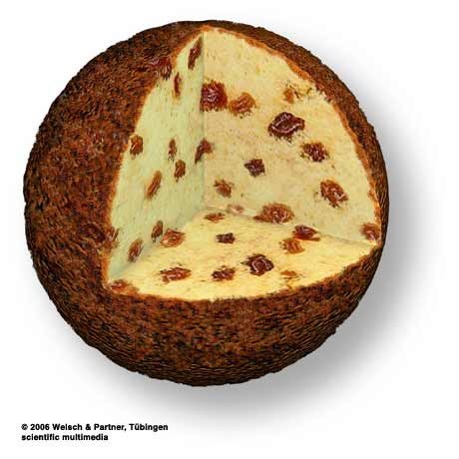
The “plum-pudding” model from Thomson
Sphere of positive charge
Electrons dotted evenly through it like currants in a plum pudding. Overall, the atom is electrically neutral.

Slide 7
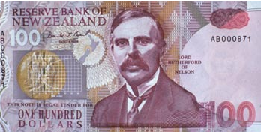
Rutherford’s Gold foil Experiment
Aim, Apparatus, Predicted Results,
Actual Experimental Results, Conclusions…

Slide 8
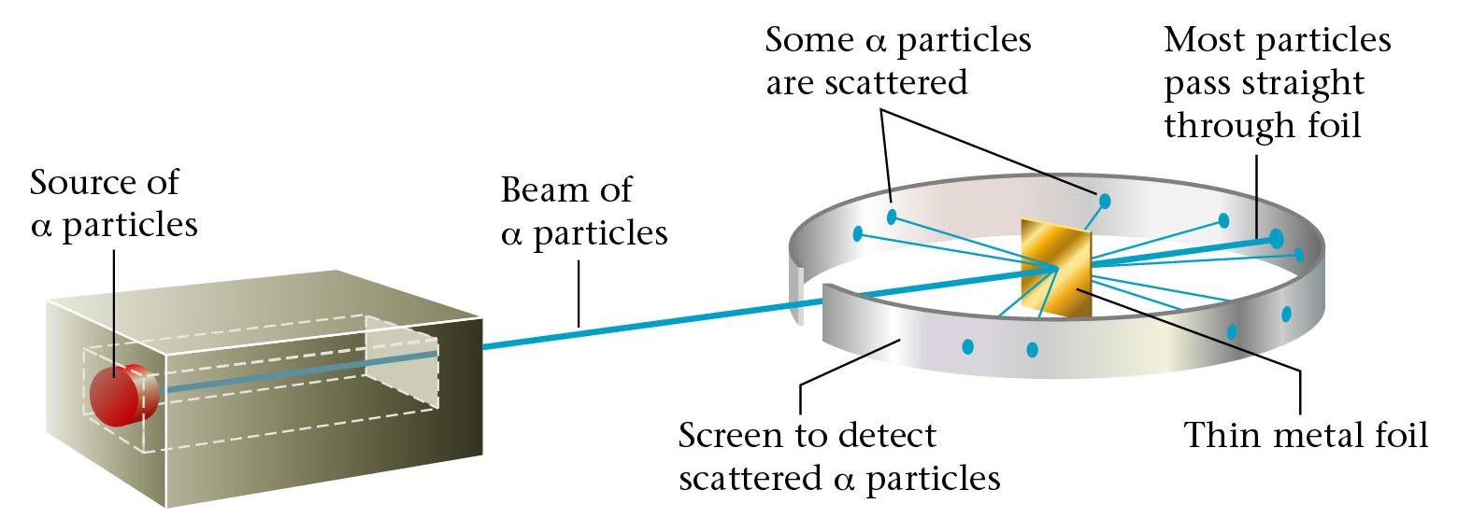
Rutherford’s Gold foil / leaf experiment
Aim:
To prove Thomson Plum Pudding Model of the Atom is correct
Apparatus:

Slide 9
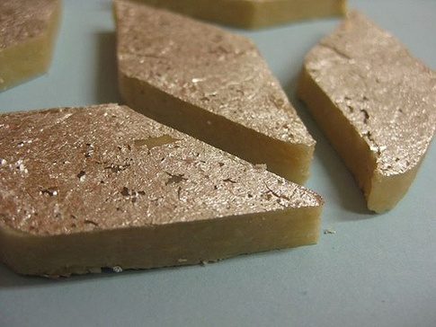
Silver and historically gold is placed in thin foils on Indian sweets.

Slide 10
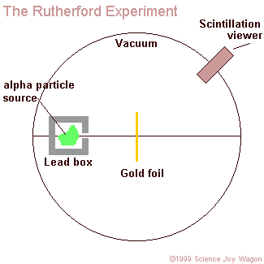
To prevent the α particles from being stopped by gas molecules
Zinc sulfide screen that would flash when hit by an alpha particle
Because it is quite easy to make very thin sheet of gold
Prevents α particles
from radiating in
other directions
(shield)
To provide a narrow beam of α particles

Slide 11
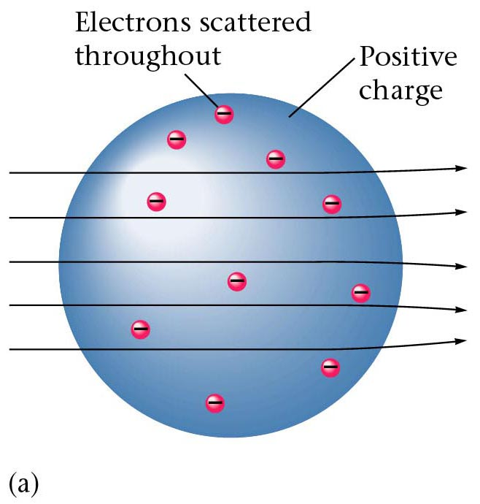
Results of foil experiment if Plum Pudding model had been correct.
Atoms of gold in foil
Alpha particle path

Slide 12
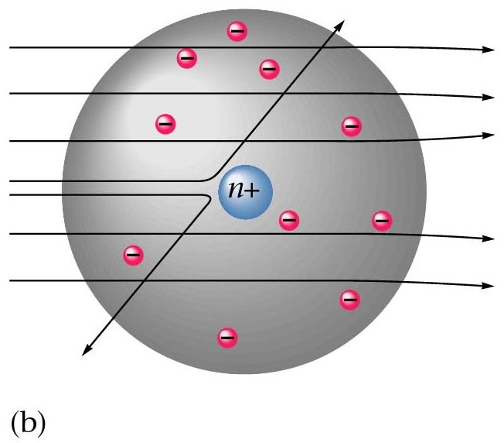
Actual Results.

Slide 13
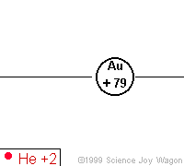
Observations and Conclusions
1.
Conclusions
Most of the α particles went straight through the gold atoms un-deflected.
Most of the gold atom is empty space.

Slide 14
Observations and Conclusions
2.
Conclusions
Significantly, about 1 in every 8000 photographs were deflected at a large angle.
The nucleus must be
positively charged to
cause the positive α
particles to be deflected.

Slide 15
Observations and Conclusions
The nucleus had to be very densely packed (and positively charged) to make the incident alpha particles bounce back i.e. come to a stop and them be turned backwards.
3.
Conclusions
A very small # of α particles rebounded (bounced back) from the gold atoms.
The nucleus must be tiny
and dense to cause a few α particles to rebound.

Slide 16
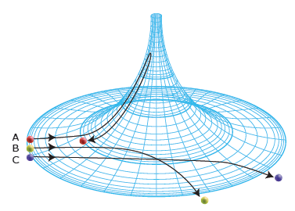

Slide 17
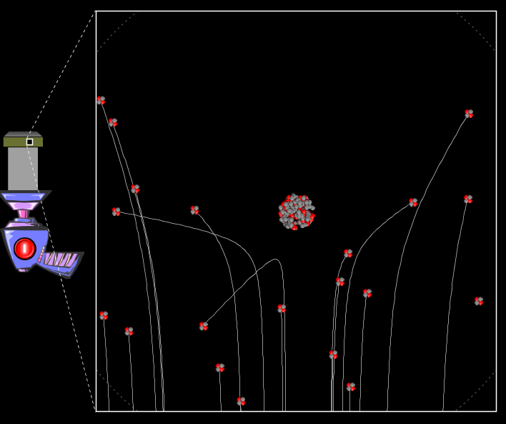
See PhET Rutherford-scattering applet

Slide 18
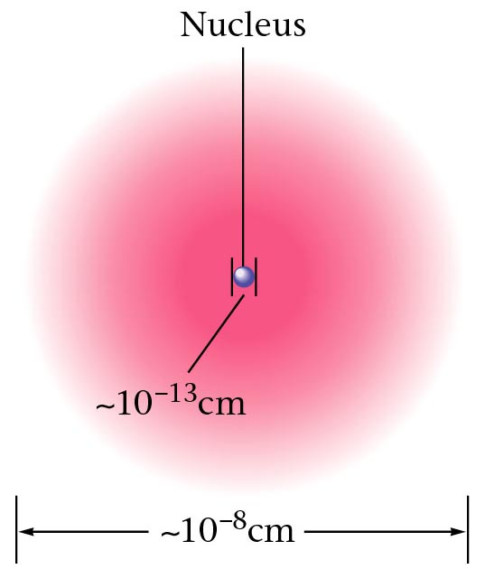
A nuclear atom viewed in cross section.

Slide 19
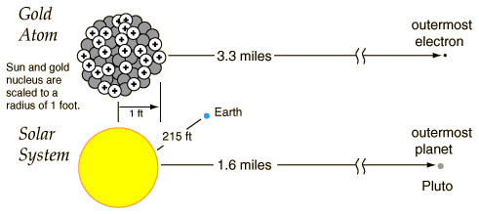
So why is the atom so empty?
Why do the electrons need such a large playground?

Slide 20
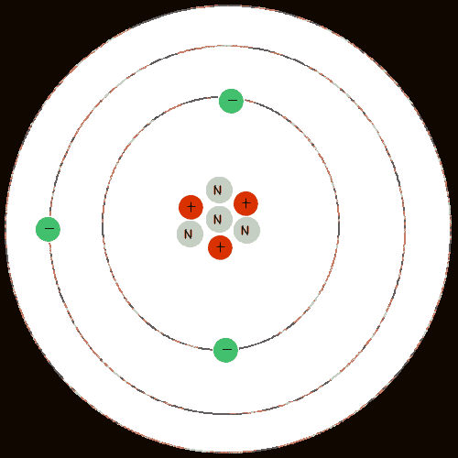
Extension
Bohr
Proposed that electrons revolve around an atom’s nucleus in particular orbits and have definite energies.
Theory worked well for Hydrogen and how atoms emit light but did not work well for larger atoms.

Slide 21
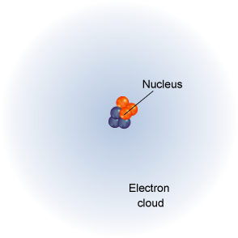
Quantum Theory
Builds on Bohr idea, atom is described using mathematical equations and the position of an electron is described in terms of its probability of being in a particular position.
Chadwick
Discovered the neutron; large neutral particles in the nucleus with mass about the same as for protons.
de Broglie
Suggests that, like light, electrons could act as both particles and waves
Schrodinger derived a set of equations or wave functions for electrons. According to Schrodinger, electrons confined in their orbits would set up standing waves and you could describe only the probability of where an electron could be. The distributions of these probabilities formed regions of space about the nucleus were called orbitals. Orbitals could be described as electron density clouds
Modern Model of the Atom ~ The electron cloud
Spherical cloud of varying density which shows
where an electron is more or less likely to be
Subatomic particles (smaller them an atom) have been suggested and discovered (??)...

Slide 22
