Slide 1
LEVEL 2 PHYSICS
Demonstrate understanding of waves
91170
NCEA EXAM
AND SOLUTIONS
2013
4 Credits
To advance through the show just click
Compiled from the NZQA resources by Jon Jaffrey May 2014. Not for commercial use.

Slide 2
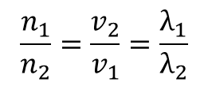
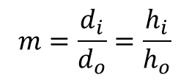
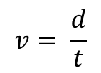
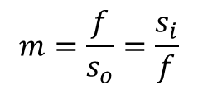
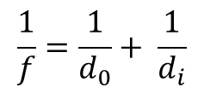
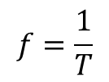
You may find the following formulae useful
$$\frac{1}{f}=\frac{1}{d_{0}}+ \frac{1}{d_{i}}$$
OR
s_{i} s_{o} = f ²
$$m=\frac{d_{i}}{d_{o}}=\frac{h_{i}}{h_{o}}$$
$$m=\frac{f}{s_{o}}=\frac{s_{i}}{f}$$
OR
$$\frac{n_{1}}{n_{2}}=\frac{v_{2}}{v_{1}}=\frac{λ_{1}}{λ_{2}}$$
n₁ sinθ₁ = n₂ sinθ₂
$$v= \frac{d}{t}$$
$$f=\frac{1}{T}$$
$v=f$λ
You are advised to spend 60 minutes answering the questions in this booklet.

Slide 3
This is the evidence statement for ALL the questions on the 2013 paper:
Not Achieved |  | Achievement |  | Achievement with Merit |  | Achievement with Excellence
N1 | N2 | A3 | A4 | M5 | M6 | E7 | E8
ONE correct Achieve point 1a | TWO correct Achieve points 2a | THREE correct Achieve points 3a | FOUR correct Achieve points 4a | ONE Merit point and THREE Achieve 1m + 3a | TWO Merit points and TWO Achieve 2m + 2a | ONE Excellence point plus TWO Merit point 1e + 2m | TWO Excellence point plus ONE Merit 2e + 1 m
Other combinations are also possible. However, in order to get M5 or M6, there should be at least one Merit question correct. To get E7 or E8, there should be at least one Excellence question correct.
For each question you get graded from 0 to 8 marks.
These marks are then added to give an overall score for the paper.
The last slide has the judgement statement which shows how this final score will give you your grade

Slide 4
QUESTION ONE : MOANA’S SPOTLIGHT
Moana is trying to design a spotlight for her school production. She experiments with a lamp in front of a mirror, as shown in the diagram here:
lamp
State the name of the position where
she has placed the lamp.
She then places the lamp further from the mirror and
notices that a light ray from the lamp reflects straight
back to the lamp, as shown in the diagram below.
(i) State the name of the position of the lamp.
(ii) Explain why the light ray reflects as shown.

Slide 5
Diagram is NOT to scale
Moana now moves the lamp closer to the mirror, as shown in the diagram here. She sees a clear image of the lamp on the wall. The height of the image is twice the height of the lamp. The focal length of the mirror is 25 cm.
wall
lamp
(c) Calculate the distance from the mirror to the lamp.
Moana attaches her mirror to the wall beside another, different mirror. When she looks at the mirrors, she sees two different images of herself as shown in the diagram below.
(d) (i) What type of mirror is:
Mirror 1 ?
Mirror 2 ?
Mirror 1
Mirror 2
(ii) Draw ray diagrams to justify your answers to part (i).
You will need to draw the appropriate mirror for each diagram.
Mirror 1
Mirror 2
Solutions to QUESTION ONE are on the next slide …………..

Slide 6
State the name of the position where
she has placed the lamp.
“ACHIEVE” for :
At the Focal Point (or Principal Focus)
lamp
She notices that a light ray from the lamp reflects straight back to the lamp, as shown
(i) State the name of the position of the lamp.
(ii) Explain why the light ray reflects as shown.
Answer :
The lamp is now at the centre of curvature.
The light from the lamp travels along a radius of the spherical section. It strikes the mirror as a normal – perpendicular at that point –and reflects back on itself.
“ACHIEVE” for :
Any ONE part correct
“MERIT” for :
BOTH parts correct

Slide 7
Moana now moves the lamp as shown here. She sees a clear image of the lamp on the wall. The height of the image is twice the height of the lamp. The focal length of the mirror is 25 cm.
wall
(c) Calculate the distance from the mirror to the lamp.
lamp
Answer :
This is an excellence question but you can get Achieve or Merit for a good attempt.
$$m=\frac{d_{i}}{d_{o}}=\frac{h_{i}}{h_{o}}$$
$$m=\frac{f}{s_{o}}=\frac{s_{i}}{f}$$
“ACHIEVE” for :
Recognition of d_{i} = 2d_{o}
OR correct S_{o}
$$2=\frac{d_{i}}{d_{o}}$$
$$2=\frac{25}{s_{o}}$$
2d_{o} = d_{i}
“MERIT” for :
Correct except for one error.
2s_{o} = 25
s_{o} = 12.5
d_{o} = 37.5
= 38cm
$$\frac{1}{f}=\frac{1}{d_{0}}+ \frac{1}{d_{i}}$$
$$\frac{1}{25}=\frac{1}{d_{0}}+ \frac{1}{{2d}_{o}}$$
“EXCELLENCE” for correct working and answer
$$\frac{1}{25}=\frac{3}{2d_{0}}$$
d_{o} = 37.5 cm
= 38 cm

Slide 8
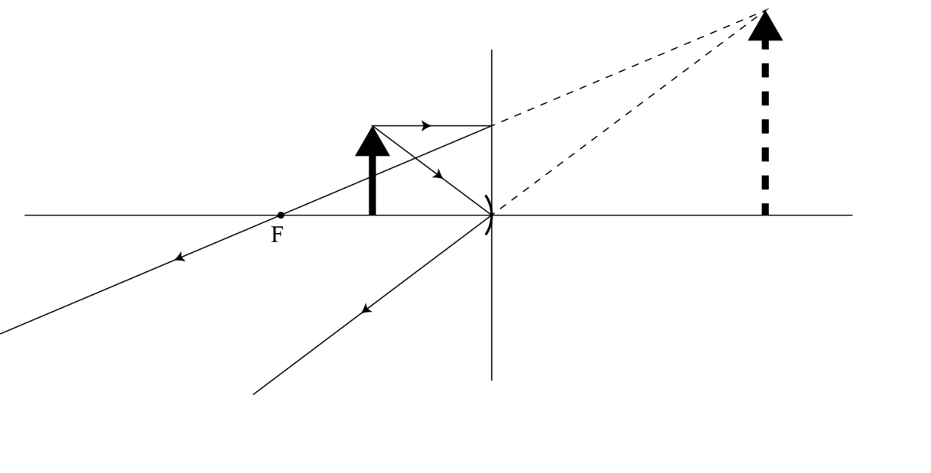
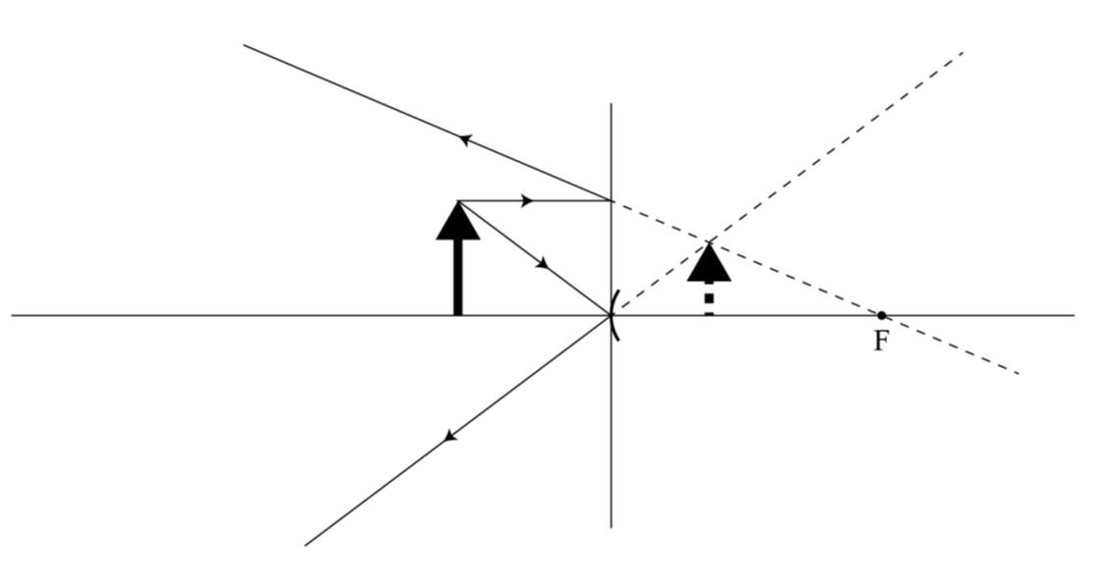
Moana looks at the mirrors, she sees two different images of herself as shown here.
(d) (i) What type of mirror is: Mirror 1? Mirror 2 ?
Draw ray diagrams to justify your answers. Draw the
appropriate mirror for each diagram.
Mirror 1
Mirror 2
Mirror 1 is concave.
Mirror 2 is convex.
“ACHIEVE” for :
TWO identifications correct.
OR
ONE correct diagram and one correct identification if concave and convex wrong way round).
“MERIT” for :
ONE correct diagram and ONE correct identification.
OR
TWO correct diagrams.
“EXCELLENCE” for :
both correct

Slide 9
QUESTION TWO: FRANKIE GOES TO THE OPTICIAN
Vitreous humour
This diagram is a simplified anatomy of the eye. Light enters through the transparent cornea, and passes through the pupil to enter the lens. The position of the lens is fixed. However, the shape, and hence the focal length, of the lens can change in order for us to be able to see objects that are far away (distant), as well as objects that are near (close). The lens focuses the light onto the retina, where an image of the object is formed.
Iris
Retina
Pupil
Cornea
Optic nerve
Lens
Frankie goes to the optician for an eye examination. The optician shines a ray of light into his cornea (at the front of his eye), as shown here:
air
transparent cornea
(a) State the size of the angle of incidence.
70°
The diagram below shows Frankie’s eye looking at a distant object.
Explain what must happen to the shape of the
lens in Frankie’s eye, in terms of focal length and
curvature, if he looks at a nearby object.

Slide 10
The lens in the eye is surrounded by liquid.
Explain what would happen to the focal length of the lens if it was surrounded by air.
Assume the lens is the same shape.
n_{air} = 1.0, n_{liquid} = 1.3, n_{lens} = 1.4
45°
The optician looks at the inside of Frankie’s eye with an instrument that uses red light. This device contains a glass prism like the one shown in the diagram here.
The speed of red light in air is 3.0 × 10⁸ m s^{–1}.
The speed of red light in the glass prism is 2.0 × 10⁸ m s^{–1}.
n_{air} = 1.0, n_{glass} = 1.5
45°
45°
Explain what happens to a beam of red light that shines into the glass prism as shown in the diagram above.
(You will need to carry out a calculation to answer this question.)
Draw the path of the beam of red light to support your answer.
Solutions to QUESTION TWO are on the next slide …………..

Slide 11
(a) State the size of the angle of incidence.
air
transparent cornea
“ACHIEVE” for :
20⁰ (90 – 70)
70°
The diagram below shows Frankie’s eye looking at a distant object.
Explain what must happen to the shape of the
lens in Frankie’s eye, in terms of focal length and
curvature, if he looks at a nearby object.
Answer :
Rays from a close object will be diverging more.
So the light will have to bend (refract) more.
So the lens will have to get fatter (more curved).
It will have a shorter focal length.
“ACHIEVE” for :
Lens will get fatter
OR
smaller f.
“MERIT” for :
Correct diagram OR explanation –
Using
eg diverging rays OR formula.

Slide 12
The lens in the eye is surrounded by liquid.
Explain what would happen to the focal length of the lens if it was surrounded by air.
Assume the lens is the same shape.
n_{air} = 1.0, n_{liquid} = 1.3, n_{lens} = 1.4
Answer :
The air has a lower refractive index than the liquid.
If light goes from air to the lens (or vice versa), it will bend (refract) more than if it goes from liquid to lens.
So light moving through air will focus closer to the lens.
So the focal length of lens in air is shorter than in liquid.
“ACHIEVE” for :
ONE correct statement.
“MERIT” for :
TWO correct statements.
“EXCELLENCE” for :
Full explanation saying what happens to focal length
OR shown by calculation

Slide 13
The optician looks at the inside of Frankie’s eye with an instrument that uses red light. This device contains a glass prism like the one shown in the diagram here.
The speed of red light in air is 3.0 × 10⁸ m s^{–1}.
The speed of red light in the glass prism is 2.0 × 10⁸ m s^{–1}.
n_{air} = 1.0, n_{glass} = 1.5
45°
45°
Explain what happens to a beam of red light that shines into the glass prism. (You will need to carry out a calculation to answer this question.) Draw the path of the beam of red light to support your answer.
45°
45°
Answer :
This is an excellence question but you can get Achieve or Merit for a good attempt.
n₁ sinθ₁ = n₂ sinθ₂
1.5 sin45 = 1 sinθ₂
1.0607 = sinθ₂
This cannot happen since sines only go between -1 and +1 !
The ray must be totally internally reflected.
1.5 sinθ_{c} = 1 sin90
sinθ_{c} = 0.66667
θ_{c} = 42⁰
The ray is totally internally reflected since i > c.
Mark scheme on the next slide…………..

Slide 14
Evidence statement from NZQA tells you what they looked for in the answer:
“ACHIEVE” for :
ONE of three points:
Correct critical angle
OR error
OR sin(angle) = 1.06
Correct explanation.
Correct path of ray.
OR Error if: 1.5sin45º = 1sinΘ is used
The angle of incidence at the glass/air interface is greater than the critical angle, so it will totally internally reflect at an angle of reflection of 45º.
Correct path of ray.
“MERIT” for :
TWO of three points:
Correct critical angle
OR error
OR sin(angle) = 1.06
Correct explanation.
Correct path of ray.
“EXCELLENCE” for :
ALL of:
Correct critical angle
OR error
OR sin(angle) = 1.06
Correct explanation.
Correct path of ray.

Slide 15
QUESTION THREE: AT THE SWIMMING POOL
Deep water
Jess and Rima are at the local pool. They notice that there is a shallow region at the edge of the pool. Waves travel through the deep water and change direction as they slow down moving into the shallow water.
On the diagram, draw waves that have entered
the shallow water.
Also draw an arrow showing the new wave direction.
Shallow water
State what happens to the frequency and wavelength of the waves when they enter the shallow water.

Slide 16
There are two pipes that drip water into the shallow pool, making circular waves. Rima notices that the dripping water produces an interference pattern in the pool, as shown in the picture below.
dripping pipes
Trough
Crest
first antinodal line
central antinodal line
Explain what would happen to the position of the first antinodal line, with respect to the central
antinodal line, if the frequency of the drips from both pipes increased and they remain in phase.

Slide 17
(d) The diagrams show waves approaching two different-sized gaps in a harbour wall.
X
A
X
B
(i) Name the process by which waves could reach positions A and B.
(ii) Explain whether the owner of a boat would do better to anchor his boat at A or B.
Support your answer by completing the wave patterns in the above diagrams.
Solutions to QUESTION THREE are on the next slide …………..

Slide 18
Waves travel through the deep water and change direction as they slow down moving into the shallow water.
On the diagram, draw waves that have entered
the shallow water.
Also draw an arrow showing the new wave direction.
Answer :
As the waves slow down the wavelength gets shorter.
The wave direction refracts towards the normal.
Be careful to keep the refracted waves parallel and with an even separation.
“ACHIEVE” for :
Either correct refracted waves
OR wave direction
OR wave direction at right angles to refracted waves.
“MERIT” for :
Correct refracted waves
AND
wave direction.
State what happens to the frequency and wavelength of the waves when they enter the shallow water.
Answer :
“ACHIEVE” for :
Frequency remains same.
Wavelength must decrease.

Slide 19
Explain what would happen to the position of the first antinodal line, with respect to the central
antinodal line, if the frequency of the drips from both pipes increased and they remain in phase.
Answer :
dripping pipes
It gets closer.
If the frequency increased, the wavelength would decrease as velocity stays the same.
The path difference to a 1st antinode is λ.
So if the path difference decreases, the 1st antinodal line will move closer to the central antinodal line.
Trough
Crest
“ACHIEVE” for :
ONE correct statement.
central antinodal line
first antinodal line
“MERIT” for :
TWO correct statements.
“EXCELLENCE” for :
Full explanation mentioning path difference
OR suitable diagram OR discussion.

Slide 20
(d) The diagrams show waves approaching two different-sized gaps in a harbour wall.
(i) Name the process by which waves could reach positions A and B.
(ii) Explain whether the owner of a boat would do better to anchor his boat at A or B.
Support your answer by completing the wave patterns in the above diagrams.
X
A
X
B
Try to keep the waves smooth. Separation all the same & the same as the incoming wavelength.
Evidence statement from NZQA tells you what they looked for in the answer:
Diffraction.
B would be best.
Correct diagram for A and B, showing semi-circular wave fronts for A.
Diagram shows wavelength remains unchanged.
Since semi-circular wave fronts are produced in the small gap that is similar in size to the wavelength of the incoming waves, a boat anchored at A would be affected by the waves.
Wave approaching the large gap do not diffract as much. Hence a boat at B would remain calm. So B is the better option for anchoring the boat.
Mark scheme on the next slide…………..

Slide 21
Evidence statement from NZQA tells you what they looked for in the answer:
Diffraction.
B would be best.
Correct diagram for A and B, showing semi-circular wave fronts for A.
Diagram shows wavelength remains unchanged.
Since semi-circular wave fronts are produced in the small gap that is similar in size to the wavelength of the incoming waves, a boat anchored at A would be affected by the waves.
Wave approaching the large gap do not diffract as much. Hence a boat at B would remain calm. So B is the better option for anchoring the boat.
“ACHIEVE” for :
TWO correct points.
“MERIT” for :
Minor error(s).
“EXCELLENCE” for :
Complete answer.
The overall judgement statement for the paper is on the next slide ……….

Slide 22
OVERALL JUDGEMENT STATEMENT: Your final grade comes from adding up your marks from all three questions
 | Not Achieved | Achievement | Achievement with Merit | Achievement with Excellence
Score range | 0 – 6 | 7 – 13 | 14 – 19 | 20 – 24
One A3 plus two N2 would just get “ACHIEVE” (= 7 )
One M6 + two A4 would just get “MERIT” ( = 14 )
Two E7 + one M6 would just get “EXCELLENCE” ( = 20 )
Compiled from NZQA resources by Jon Jaffrey May 2014. Not for commercial use.

