Slide 1
Work, Energy & Power

Slide 3
Review & build on Y11 mechanics and introduce Spring Potential Energy

Slide 4
p67

Slide 5
Work done = Energy Changed
Whenever work is done, energy is transformed.
Energy in one form
WORK is done
Energy in another form

Slide 7
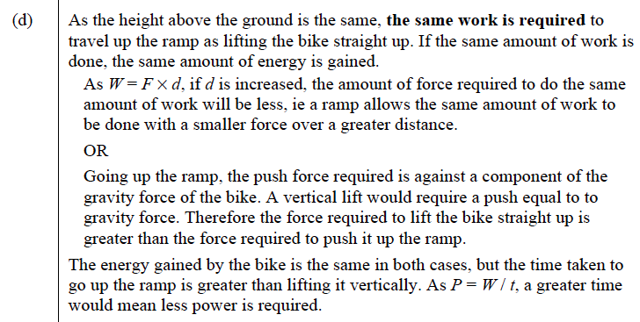

Slide 9
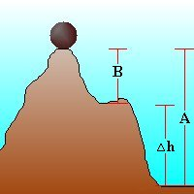
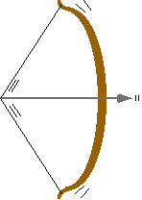
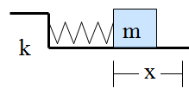
Energy can be classified as potential (stored or positional) or kinetic (moving)
An object can have potential energy by virtue of its position.
Gravitational potential Energy
An object at some height above the ground
The boulder has more gravitational potential energy when measured from point A compared to B.
Spring potential Energy
A wound-up spring
A stretched elastic band
Kinetic Energy (moving)

Slide 10
Conservation of Energy
Energy just changes into different forms.
The total amount of energy stays the same!
Energy changes between potential & kinetic energies
Inelastic collisions - energy will be lost due to friction (heat & sound)
Elastic collisions ~ no energy lost to friction

Slide 11
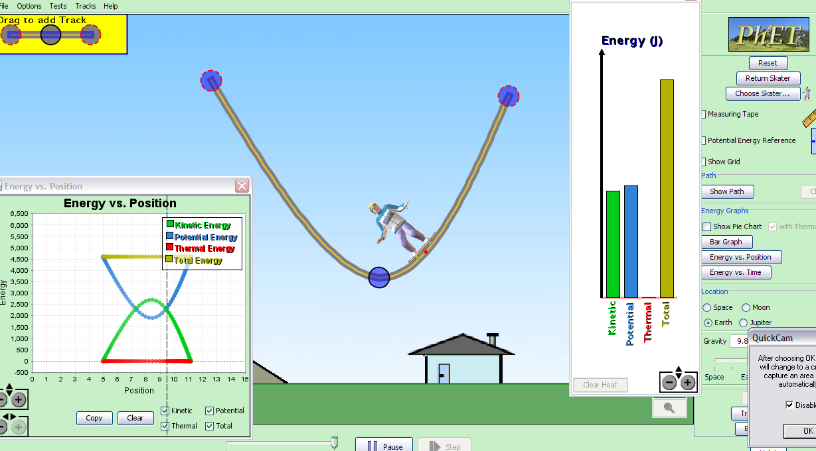
See Energy Skate Park applet

Slide 12
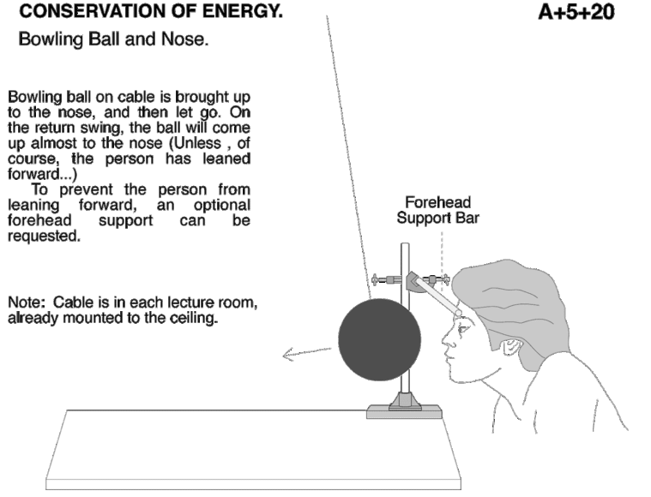

Slide 13
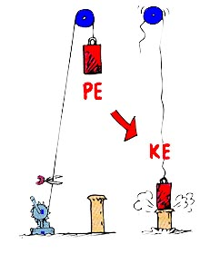
What is the impact Velocity?
dropped from rest
V?

Slide 14
WORK = FORCE X DISPLACEMENT
(joules) (newton) (meter)
W = Fd
W = ΔE_{k}
Notes:
http://ngsir.netfirms.com/englishhtm/Work.htm

Slide 15
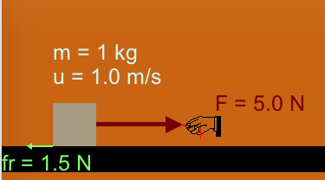
M
Assume d = 5.13m
What is the Work done? Calculate V_{f}?

Slide 16
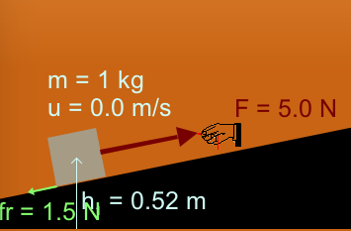
Incline plane
Assume:
d = 5.3 m
h₂ = 1.6 m
What is V_{f}?
E
W = Fd
W = ΔE_{k} + ΔE_{p}

Slide 17
Power
Energy can be transferred from one form to another
through the process of work. The rate at which work
is done is called power
Average power
The units of power are watts 1W = 1 Js⁻¹

Slide 18
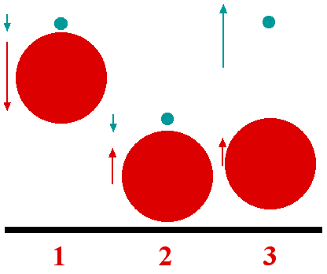
Two's company, three's a crowd: solution
If we drop the ping-pong ball vertically from rest from a height H above the ground then it will hit the ground at a speed V given by V² = 2gH, where g is the acceleration due to gravity. If the bounce is perfectly elastic then it will rebound to a height H.
Now drop the ping-pong ball and the basket ball from the same height so they are initially almost touching, with the basket ball closer to the ground. Ignoring the slight separation between the two balls and their sizes and assuming the bounces are all perfectly elastic, the basket ball rebounds from the ground with speed V and hits the ping-pong ball when it is still falling at speed V.
So, relative to the basket ball, the ping-pong ball rebounds upwards at speed 2V after its velocity gets reversed by the collision. Since the basket ball is moving at speed V relative to the ground this means that the ping-pong ball is moving upwards at
2V + V = 3V
relative to the ground after the collision. Since the height reached is proportional to V² this means that it will rise 3² = 9 times higher than in the absence of its collision with the basket ball. In practice the loss of energy incurred at the bounces will ensure that it rises a little less than this.
Notes:
http://plus.maths.org/content/plus-magazine-4

