Slide 2
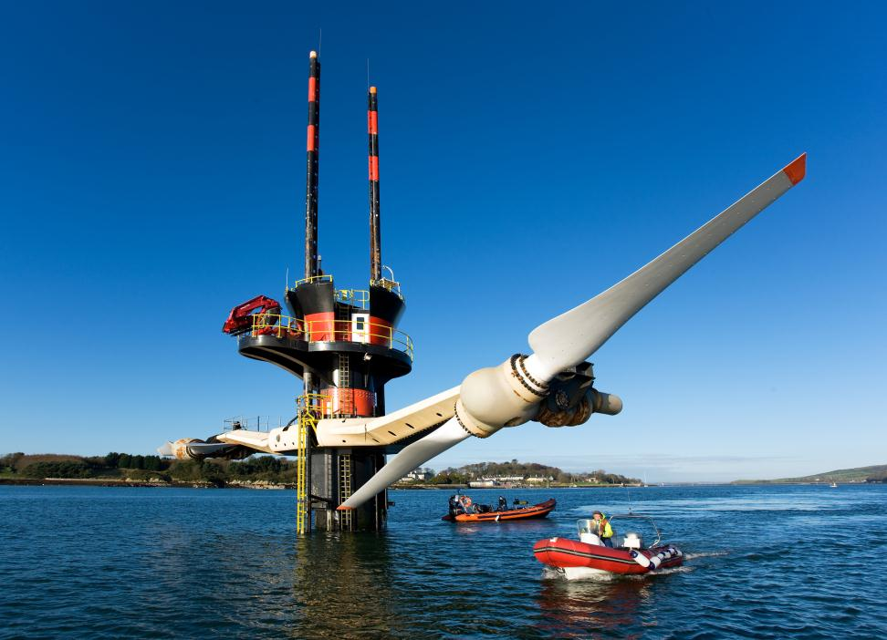

Slide 4
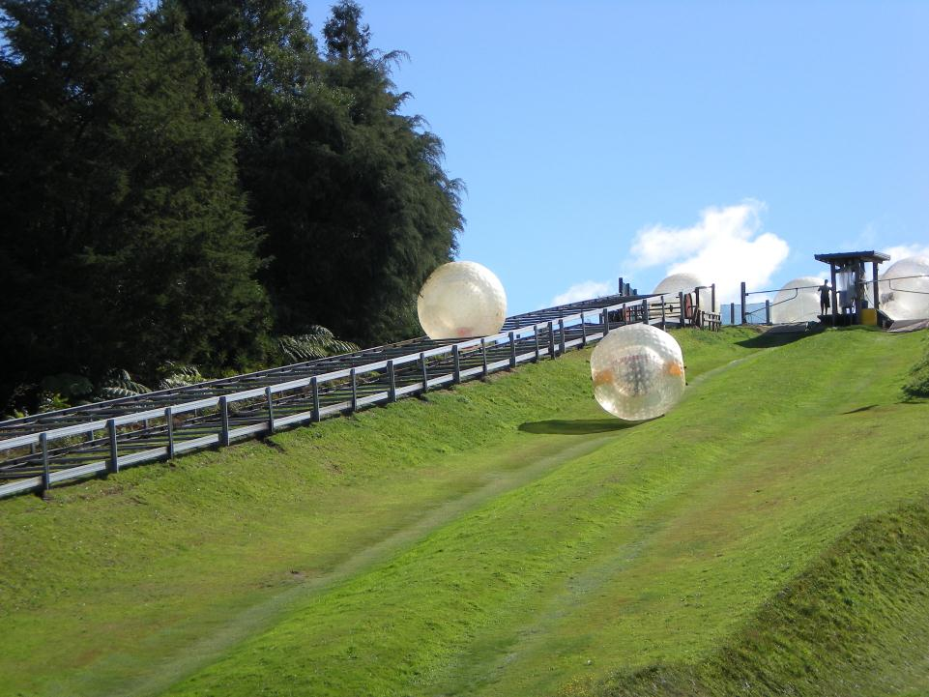

Slide 5
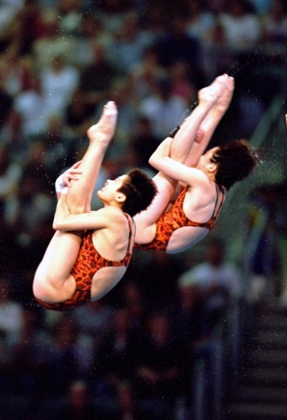
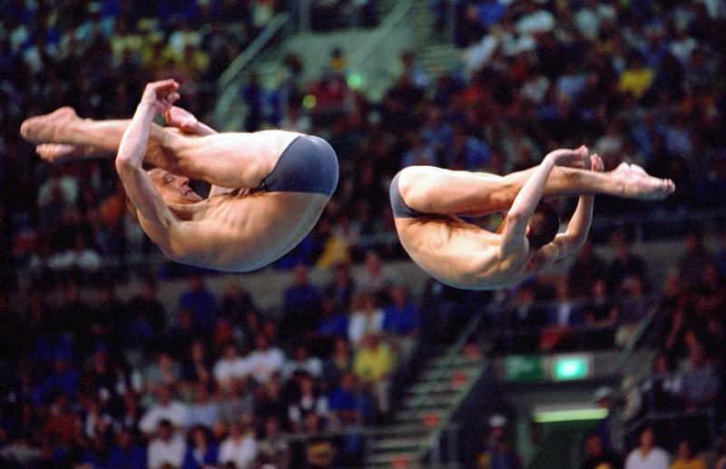

Slide 6
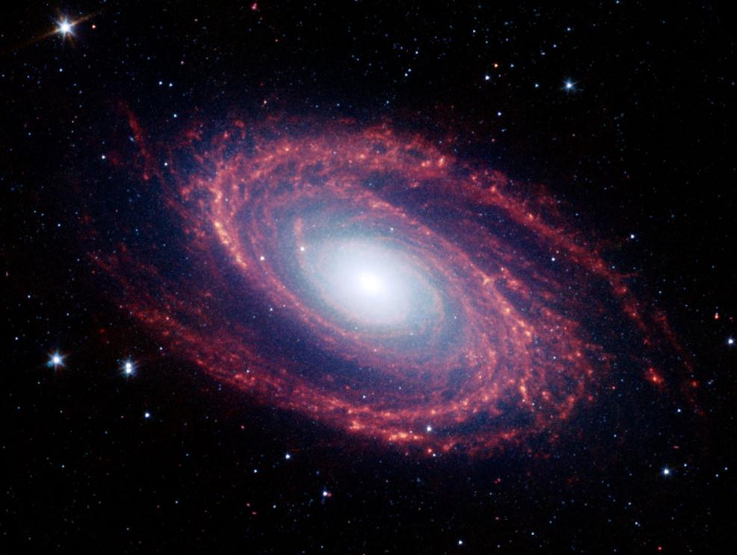

Slide 7
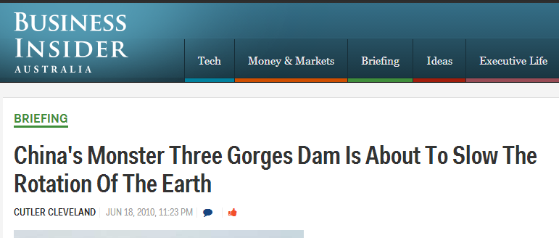
http://www.businessinsider.com.au/chinas-three-gorges-dam-really-will-slow-the-earths-rotation-2010-6#ixzz2gLFLVmuJ

Slide 8
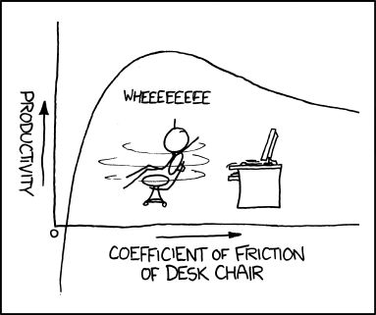

Slide 9
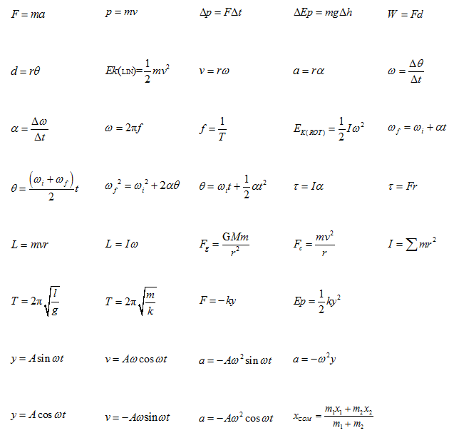

Slide 10
Translation (Linear motion)- All points move through the same distance in the same time.
Rotation (Angular motion)- All points move through the same angle in the same time.
Axis of Rotation

Slide 11
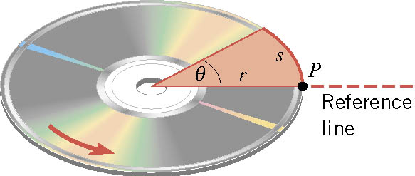
Angular Position (θ)
d
$$θ=\frac{d}{r}$$
θ is measured in radians
d = arc length
r = distance of a point from the axis
Notes on radians (rad):
1 revolution = 360° = 2π rad
Radians are a dimensionless unit
Don’t reset θ to zero after one revolution:
1 revolution = 2π rad,
1 ½ revolutions = 3π rad,
2 revolutions = 4π rad, etc…

Slide 12
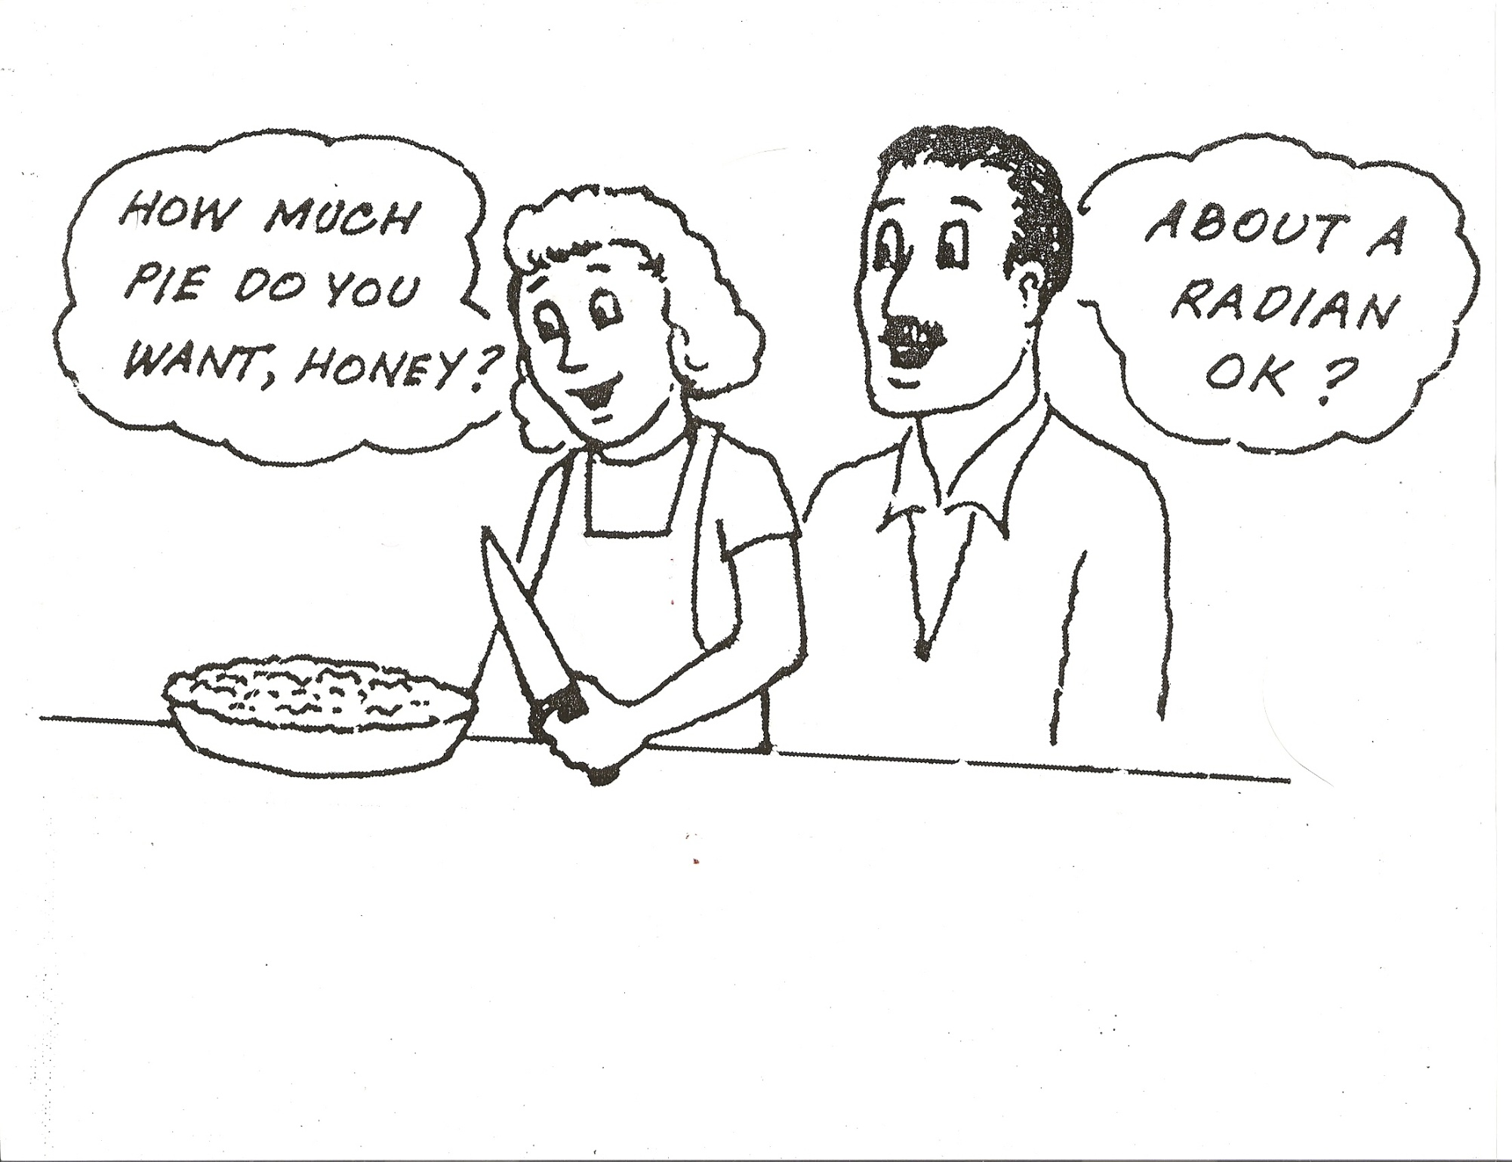
d

Slide 13
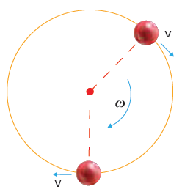

Slide 14
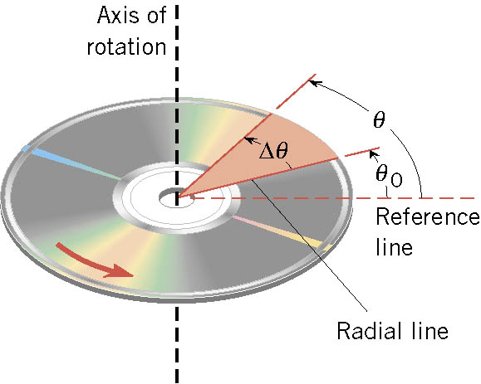
Angular Displacement (Δθ)
Δθ = θ_{f} - θ_{i}
Counterclockwise (CCW) +
Clockwise (CW) -

