Slide 1
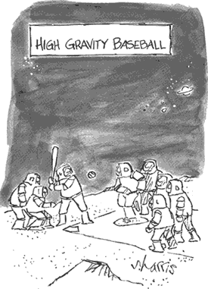
How well do you get the joke?

Slide 2
One dimensional motion:
-x
+x
+y
Now:
-x
+x
-y

Slide 3
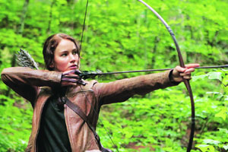
https://www.youtube.com/watch?v=xj2L4LbYD7Q

Slide 4
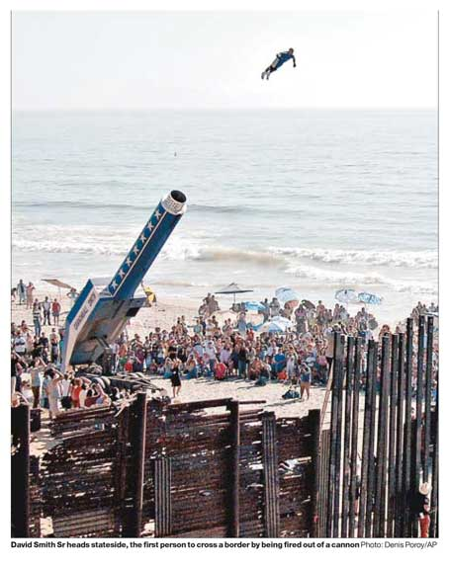

Slide 5
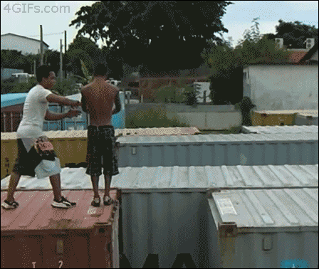

Slide 6
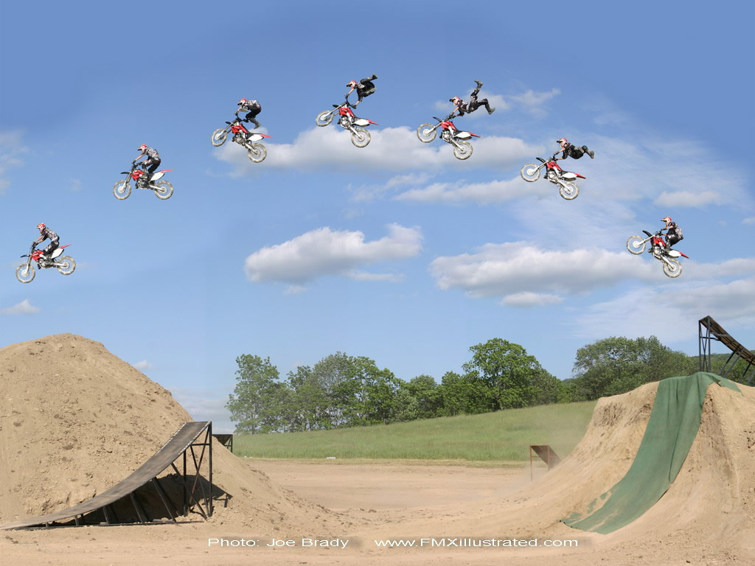
Projectile Motion

Slide 7
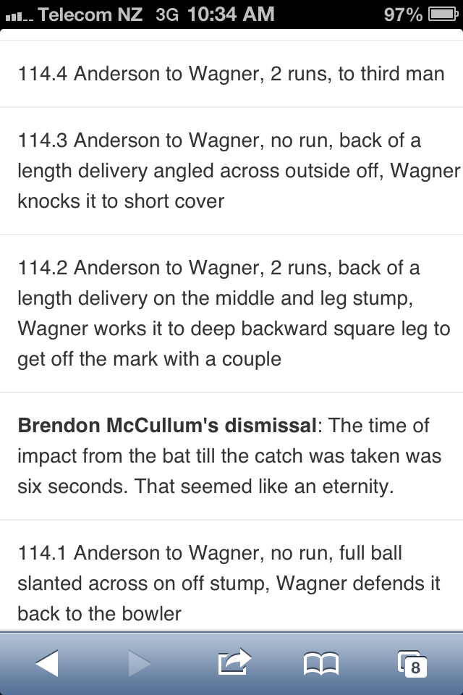

Slide 8
What is a Projectile?
Key Concepts:
Only force is due to gravity
Anything that moves (in air) where the only force acting is (due to) gravity.
Is a moving football is a projectile?
Yes, if you assume
Gravity is the only force acting

Slide 9
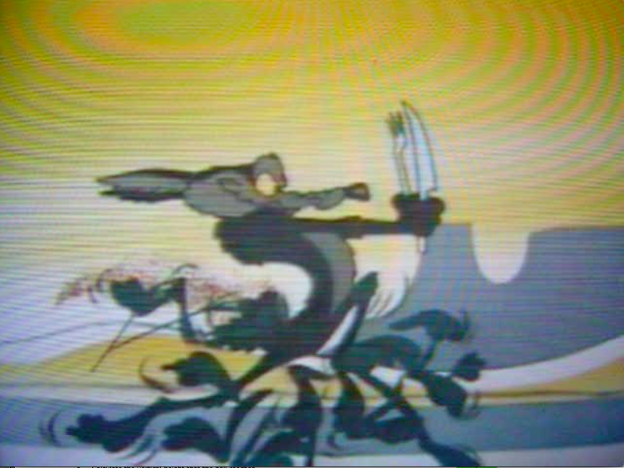

Slide 10

Key Concepts:
think vectors…
The instantaneous velocity v is always tangential to the path of the object
v
v
v
v_{x} = x-component of velocity
v_{x}
v_{y} = y-component of velocity
v_{y}
v
v_{x}
v
v_{y}

Slide 11
Key Concepts:
V_{ix} = V_{fx} as a_{x}= 0
V_{i} = Initial Velocity
θ = angle to the ground
Initial Horizontal velocity
v_{ix} = v_{i} cos θ

Slide 12
Key Concepts:
V_{iy} changes as a_{y}= -g
Initial vertical component of velocity
v_{iy} = v_{i} sin θ
V_{i}
θ = angle to the ground

Slide 13
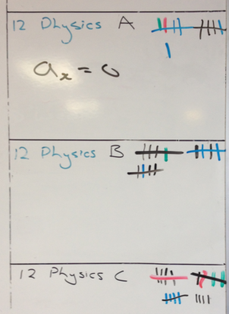
2014!

Slide 14
Key Concepts:
Learn this diagram
Time up = time down
(to same height)
Vertical velocity at maximum height
V_{y} = 0 m s⁻¹
t_{air} = 2t_{top}
projectile path is a parabola
Maximum Height
(occurs at half range)
Horizontal distance = RANGE

Slide 15
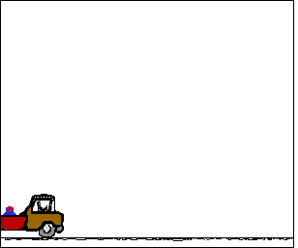

Slide 16
