Slide 1
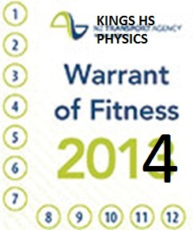
2016
Physics WoF
Start the year right
with a 

Slide 2
Uncertainty
Physical Quantities
Accuracy
vs
Precision
SI Units
Physical
Quantities
Prefixes
Unit Conversion
Significant
figures
Scientific
Notation

Slide 3
Physical Quantities
SI Units
Physics
WoF
Physics involves measuring Physical Quantities…
7 defined ‘base’ Physical Quantities!

Slide 4
Base Quantity |  | Base Unit
Name | Symbol | Name | Symbol
Time
t
second
s
Length
l
metre
m
Mass
m
kilogram
kg
Temperature
T
kelvin
K
Electric Current
I
ampere
A
Amount of Substance
n
mole
mol
Luminous Intensity
candela
cd

Slide 5
Units of measurement
Ex: miles, feet, inches, hours, gallons, pounds, liters…
SI units (metric)
Length: meter (m)
Time: second (s)
Mass: kilogram (kg)
Base Units
(Other units derived from
these)
Volume: m³
Speed: ms⁻¹
Power: (kg)(m²)s⁻³ = 1 Watt

Slide 6
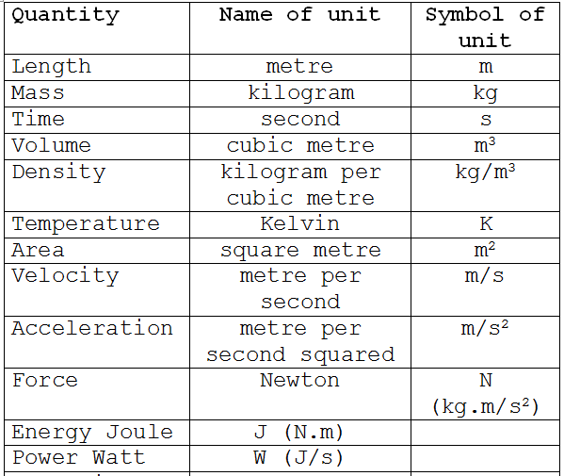

Slide 7
Physical Quantities
SI Units
Physics
WoF
Prefixes

Slide 8
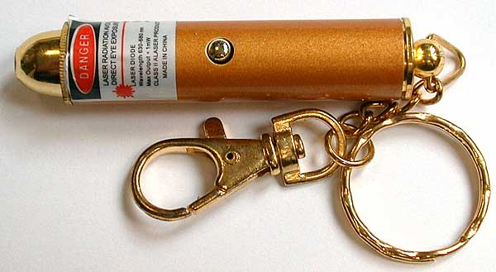

Slide 9
Prefix multipliers
Power | Prefix | Symbol
10¹² 10⁹ | tera giga | T G
10⁶ | mega | M
10³ | kilo | k
10⁻³ | milli | m
10⁻⁶ | micro | μ
10⁻⁹ | nano | n
10⁻¹² | pico | ρ

Slide 10
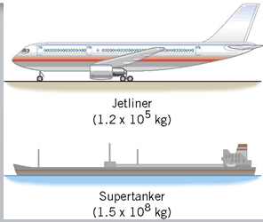
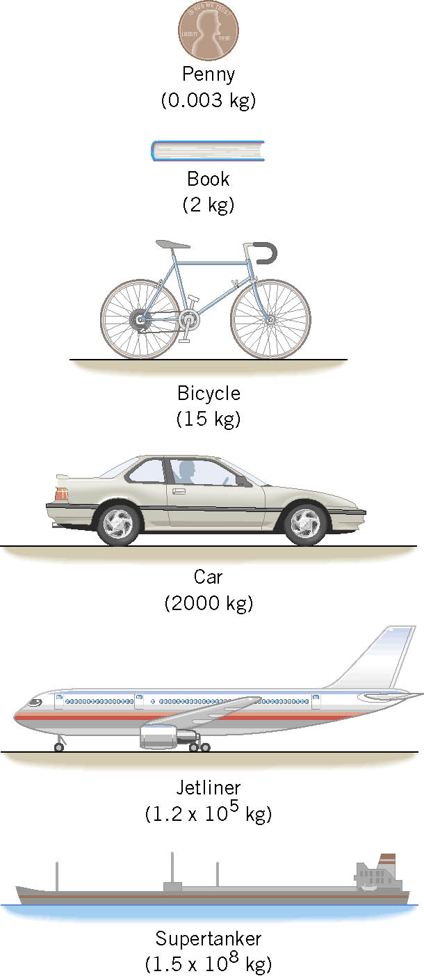
Awake? – covert to grams
with appropriate prefix
Power | Prefix | Symbol
10¹² 10⁹ | tera giga | T G
10⁶ | mega | M
10³ | kilo | k
10⁻³ | milli | m
10⁻⁶ | micro | μ
10⁻⁹ | nano | n
10⁻¹² | pico | ρ

Slide 11
Physical Quantities
SI Units
Physics
WoF
Prefixes
Significant
figures

Slide 12
Significant Figures
The number of significant figures expresses the precision of the measurement.
Examples:
4
3456
2
2300
2
0.0045
2
5.0 x 10⁵
3
1.04
0.00358
3
4
54.00

Slide 13
Spot quiz
49382 to 2 s.f. =
0.05961 to 1 s.f. =
374.582 to 3 s.f. =
0.0009317 to 2 s.f. =
49000
0.06
375
0.00093
Fill in zeros up to but not after the decimal point.

Slide 14
Physical Quantities
SI Units
Physics
WoF
Prefixes
Significant
figures
Scientific
Notation

Slide 15
Scientific notation
A way of representing numbers that are very large or very small
Distance from the Earth to the Sun:
150,000,000,000 m = 1.5 × 10¹¹ m
Diameter of an atom:
0.0000000001 m = 1.0 × 10⁻¹⁰ m
= 0.1 nm
Here’s the rule: Zeroes that only exist to separate other numbers from the decimal don’t count as significant figures.

Slide 16
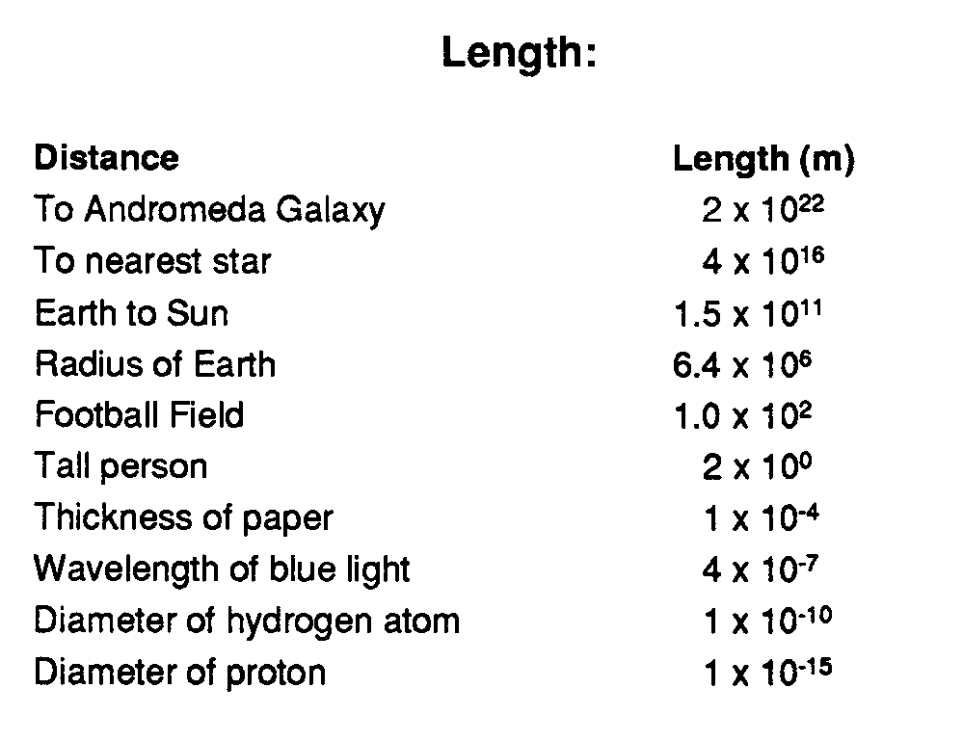

Slide 17
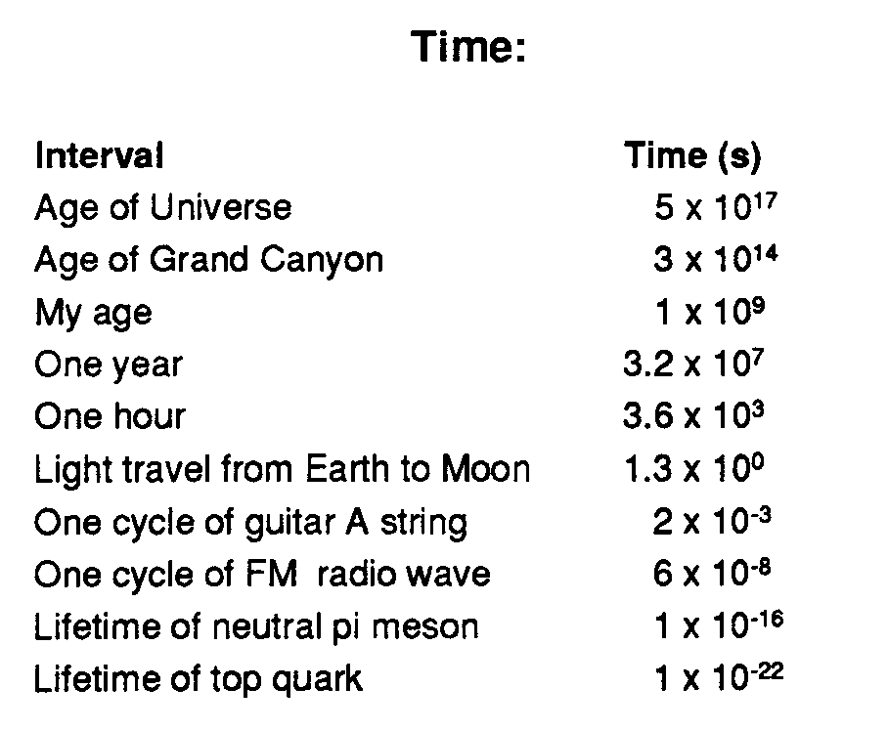

Slide 18
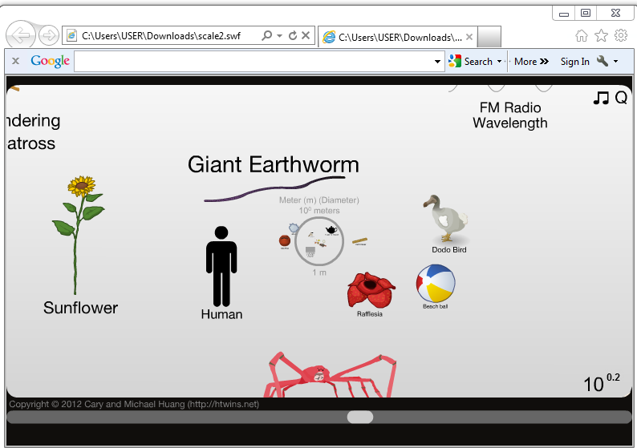
The Scale of the universe

Slide 19
xxxxxxxxxxxx | Decimal Form | Standard Form | Round to 3 Sig Figs
xxxxxxxxxxxx | 91068.0
xxxxxxxxxxxx | 0.08020
146.5 x 10⁶
22.63 x 10⁻³

Slide 20
xxxxxxxxxxxx | Decimal Form | Standard Form | Round to 3 Sig Figs
xxxxxxxxxxxx | 9170.80
xxxxxxxxxxxx | 0.008998
14.95 x 10⁵
228.68 x 10⁻³

Slide 21
Physical Quantities
SI Units
Physics
WoF
Prefixes
Unit Conversion
Significant
figures
Scientific
Notation

Slide 22
Conversions
Convert 572 centimetres to metres.
Convert 80 km to metres

Slide 23
Conversions
Convert 24 hours to seconds
Show 50 km h⁻¹ ≡ 14 m s⁻¹
Show 20 m s⁻¹ ≡ 72 km h⁻¹

Slide 24
Uncertainty
Physical Quantities
Improve?
Accuracy:
SI Units
Precision:
Physical
Quantities
Random
Systematic
Human
Prefixes
Unit Conversion
Significant
figures
Scientific
Notation

Slide 25
how close the measurement is to the true value
Accuracy:
Precision:
how many significant digits
There will always be some error in a measured value. A measurement is only an estimate of the true value.

Slide 26
A gold coin is measured on a very accurate and precise scale to have a mass of 127.96458 grams.
A second scale gives a reading of 128 grams.
The second scale is accurate but not precise.
A third scale gives a reading of 135.21568 grams.
The third scale is precise but not accurate.
A fourth scale gives a reading of 115 grams.
The fourth scale is neither accurate nor precise.

Slide 27
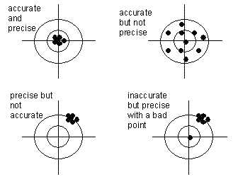

Slide 28
Measurement / Experimental Errors
Errors produced by unpredictable and unknown variations. Measurements are spread randomly around an average value.
1) Random:
2) Systematic:
Errors that give results consistently above or below the true value, eg:
Calibration error
Zeroing error
Parallax error
3) Human:
Misreading of scales / instrument
Bad maths / wrong equation used
Transcription error
Accuracy?
Precision?

Slide 29
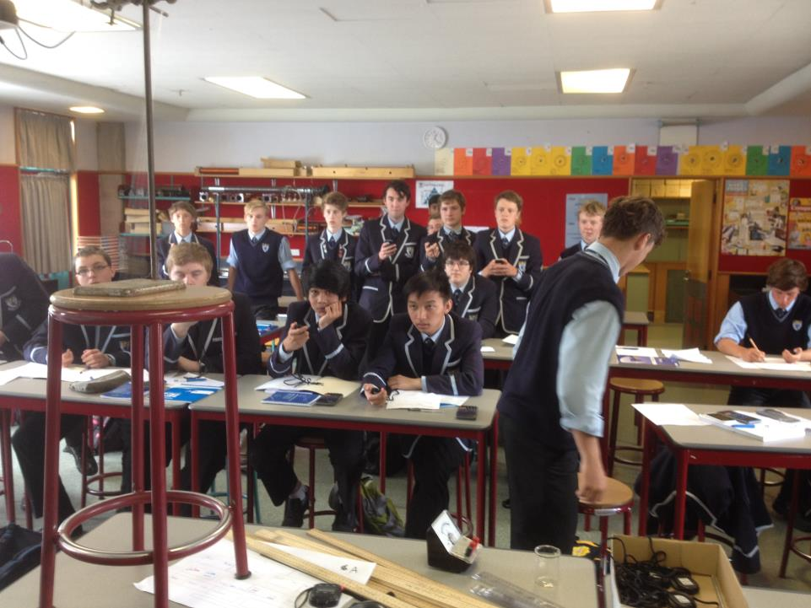

Slide 30
IMPROVING ACCURACY
Observer and/or instrument placement - parallax error
Use appropriate significant figures
Beware of Zeroing / Calibration errors
Average repeated measurements (ie for time data)
Collect sufficient data (eg when looking for a relationship – need at least 5 lots of data)

