Slide 1
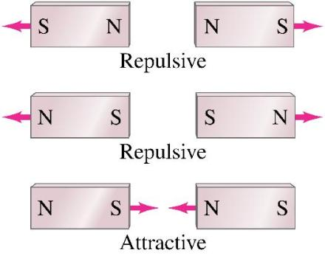
Magnets and Magnetic Fields
Magnets have two ends – poles – called north and south.
Like poles repel; unlike poles attract.

Slide 2
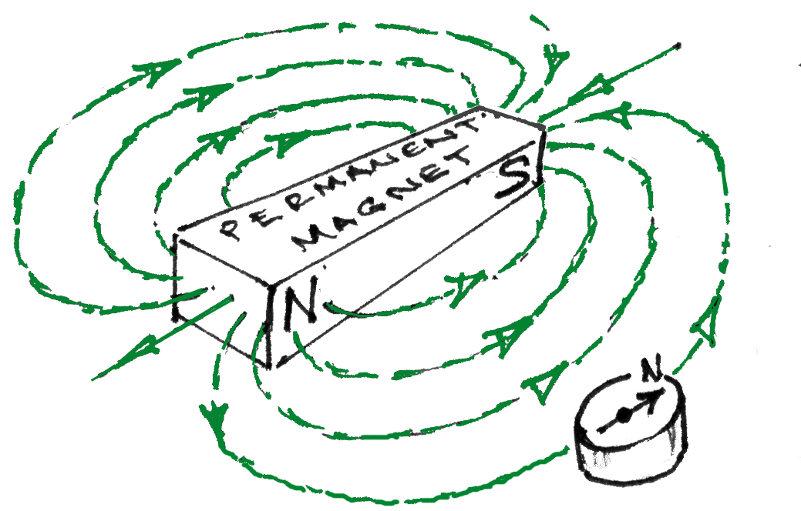
Plotting Compasses show the Magnetic field direction

Slide 3
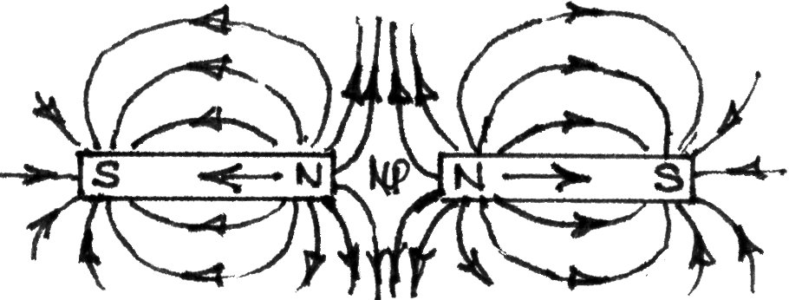

Slide 4
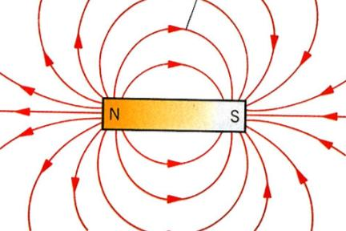
Recall: Electric Field (E) points from + to - charge
Magnetic Field (B SI unit ~ T tesla) points from “North” to “South” poles
opposite poles attract like poles repel
“South sux ~ North blows”
Magnetic Field Lines
B is tangent to the field lines at any point
The density of the lines represents the strength of the magnetic field

Slide 5
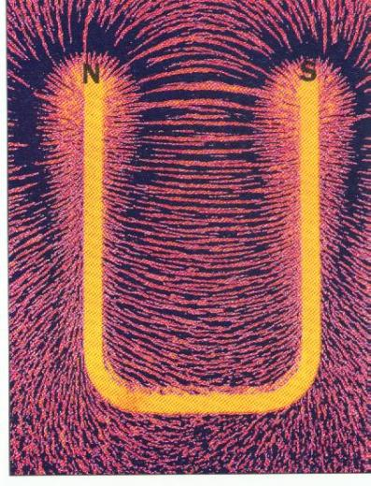
The region of space in which a magnetic force is experienced is called a magnetic field.

Slide 6
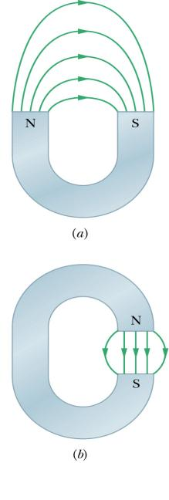
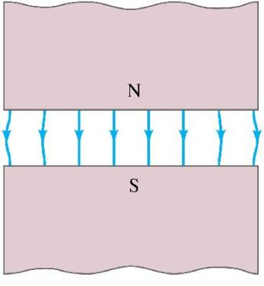
A uniform magnetic field is constant in magnitude and direction.
The field between these
two wide poles is nearly uniform.

Slide 7
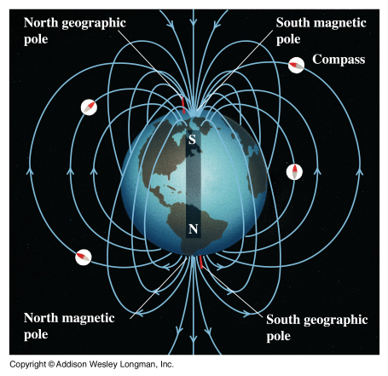

Slide 8
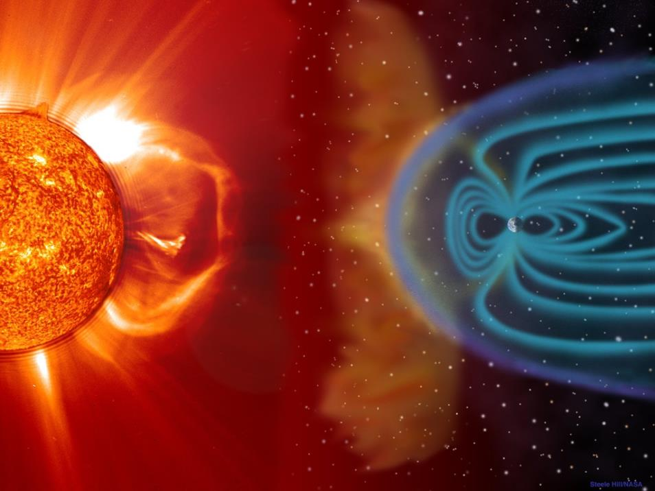

Slide 9
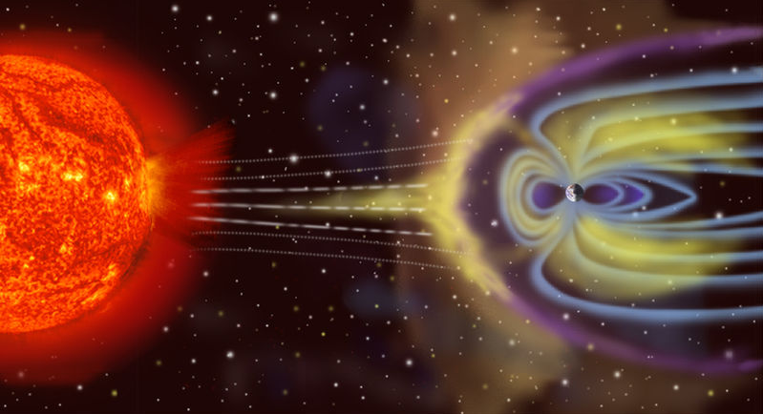
Rewrite the statement below and fill in the missing words.
Not to scale
Artist's rendition of Earth's magnetosphere. This is in the public domain, it was created by NASA.
The Earth's magnetic field is similar to that of a bar magnet, but this similarity is superficial. The magnetic field of a bar magnet, or any other type of permanent magnet, is created by the coordinated spins of electrons and nuclei within iron atoms. The Earth's core, however, is hotter than 1043 K, the Curie point temperature at which the orientations of spins within iron become randomized. Such randomization causes the substance to lose its magnetic field. Therefore the Earth's magnetic field is caused not by magnetized iron deposits, but mostly by electric currents in the liquid outer core.

Slide 10
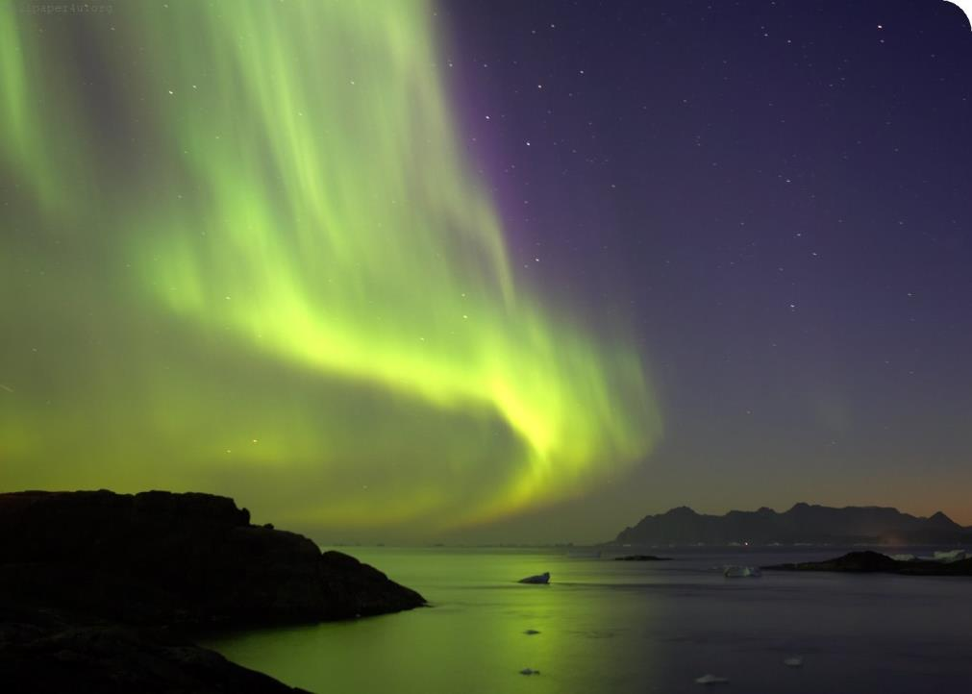

Slide 11
