Slide 1
Why graph?
Proportionality
Variables
Relationships
Drawing a LBF
Graph
Skills
Linear
relationship
Non -Linear
relationships
(2.1 investigation)
Spikes / outliers
Determining
a gradient
y = mx+c
Data
Transformation
Solving
a constant
Units

Slide 2
Why graph?
GRAPHS AND RELATIONSHIPS
A scientist studies data gathered from an experiment in an attempt to establish a (mathematical) relationship.
Common relationships: Linear (or directly proportional), square, inversely proportional, inverse square, square root.
The clearest and simplest way to see a relationship is to plot a graph.

Slide 3
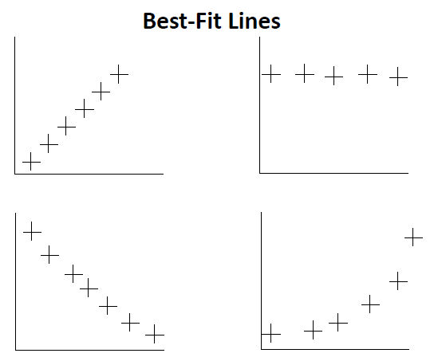

Slide 4
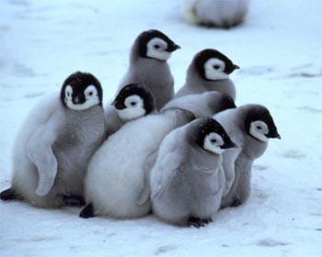
Do you know your variables?
Who will cool down faster, a penguin on its own, or a penguin in a huddle?

Slide 5
Relationship Variables:
the independent variable - the one you are testing
the dependent variable - the one you are measuring
the controlled variables - all other variables that are kept constant (unchanged)
Why be concerned about control variables?

Slide 6
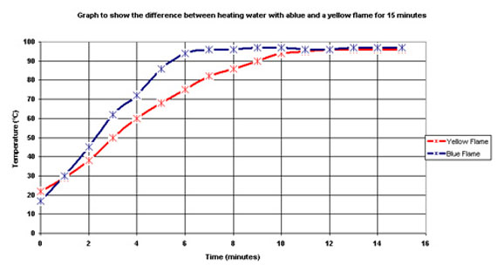
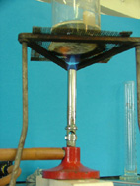
Why be concerned about control variables?

Slide 7
Drawing a LBF
Be sure to:
Independent variable (usually plotted on the x axis)
the variable that you have control over
Dependent variable (usually plotted on the y axis)
this is the quantity that you have to measure and is affected by how you alter the independent variable.
Label the axes and use the units
Sensible scale please
Plot the points
Draw a best fit line
If it looks like it should be a straight line then use a ruler
If it looks like a curve then draw a best fit freehand curve

Slide 8
Determining a gradient
Gradient = Rise / Run

Slide 9
Gradient
Calculate the gradient of this graph
d (m)
correct unit
45
40
35
30
25
20
15
10
A
Merit
correct sig.fig
A
M
Δd = 30 m
Δt = 7 s
5
0
1 2 3 4 5 6 7 8 9 t (s)

Slide 10
Gradient Units
The gradient of the graphs have been worked out for you.
Write down the units of the gradient for each graph.
d (m)
F (N)
t (s)
x (m)
= 5
m s⁻¹
= 0.75
N m⁻¹

Slide 11
L (m)
L (m)
t² (s²)
(s^{½})
= 5
m s⁻²
= 6
m s^{-1/2}

Slide 12
Example 1:
Distance Time graph:
$$v=\frac{d}{t}$$
Time (s) | Distance (m)
0 | 0
1 | 2
2 | 4
3 | 6
4 | 8
5 | 10
6 | 12
independent variable:
dependent variable:
control variables:
Aim: determine Velocity of ball

Slide 13
What are the units?

Slide 14
What are the units?

Slide 15
Ask yourself what is the relationship? i.e. is y α x?
y is proportional to x

Slide 16
What is the gradient?
$$Gradient= \frac{Rise}{Run}$$
$$Gradient= \frac{4}{2}=2$$
Rise:
Do not use data points to find your gradient but use ‘easy’ and ‘well spread’ points from your LBF
Run:

Slide 17
What are the units of the gradient?
Rise:
$i.e.$2 ms⁻¹
Run:

Slide 18
What is the equation of a straight line?
The equation of a straight line is:
Y = m x + c
Y10 Math… Nothing new!

Slide 19
What is the Mathematical relationship ?
All straight line graphs are of the form y = mx + c
$$Gradient= \frac{4}{2}=2$$
$$Gradient units: \frac{y−axis unit}{x−axis unit}$$
Rise:
$$Gradient units: \frac{m}{s}$$
$i.e. 2 \frac{m}{s}$ or 2 ms⁻¹
Run:

Slide 20
Example 2:
Velocity Time graph:
a$=\frac{v}{t}$
Time (s) | Velocity (ms⁻¹)
0 | 0
1 | 3.5
2 | 9
3 | 11
4 | 17
5 | 21
6 | 26
independent variable:
dependent variable:
control variables:
Aim: determine acceleration of ball

Slide 21
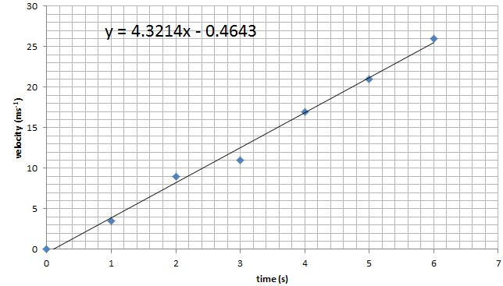
a$=\frac{v}{t}$
What is the Mathematical relationship ?

Slide 22
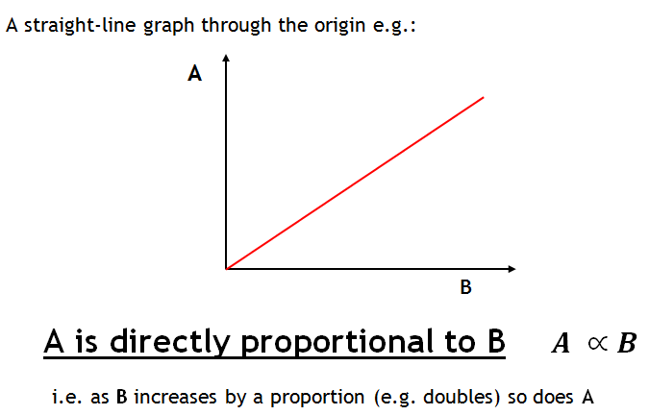

Slide 23
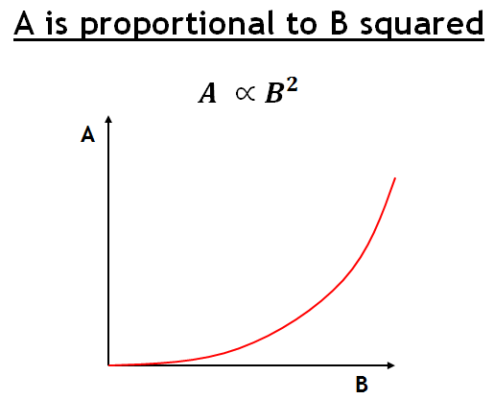
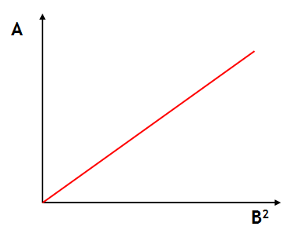

Slide 24
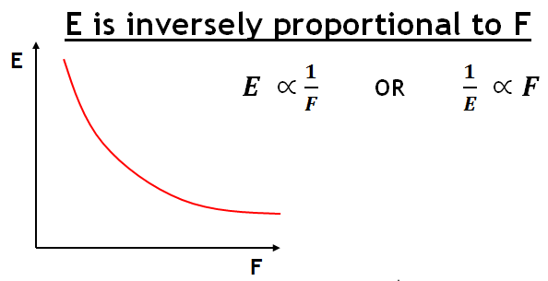
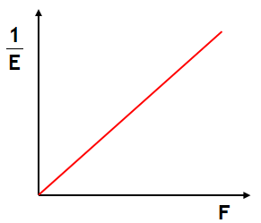
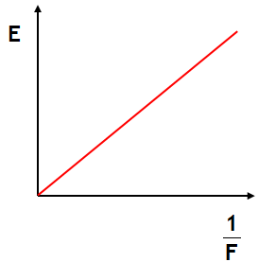
The mathematical relationship is $\frac{1}{E}=k F$
Where k = the gradient of the line
The mathematical relationship is $E=k\frac{1}{F}$

Slide 25
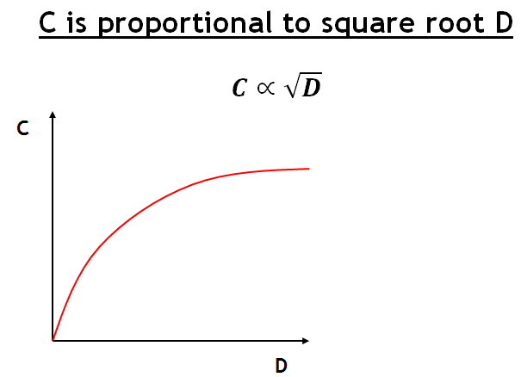
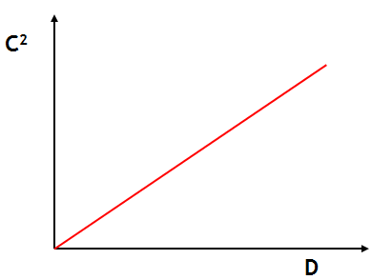
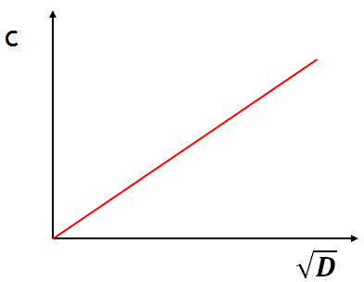
C = k $\sqrt{D}$
C² = k D

