Slide 1
Electrons, Charge & Current
Electrons - negative charge.
Charge (Q) is measured in coulombs (C) 1C = 6x10¹⁸ e
What is the charge on ONE electron?
1e = 1.6 x10⁻¹⁹ C
The movement of electric charges is called current (I), unit (A).
The size of electric current (I) is the rate at which charge flows
Time t
q
note 1A = 1Cs⁻¹

Slide 2
There are 2 types of current:
AC – Alternating Current – changes direction periodically.
DC – Direct Current – always flows in the same direction.
Electrons flow in the opposite direction
Direction of ‘conventional’ current
-
+
Conventional current is the flow of imaginary positive particles from the positive terminal of a power supply to the negative terminal.
Electron flow is the flow of actual negative charges from the negative terminal to the positive.

Slide 3
Standard convention has current flowing from the positive terminal to the negative terminal.
This convention is credited to Benjamin Franklin who theorized that electric current was due to a positive charge moving from the positive terminal to the negative terminal.
However, it was later discovered that it is the movement of the negatively charged electron that is responsible for electrical current.
Rather than changing several centuries of theory and equations, Franklin's convention is still used today!

Slide 4
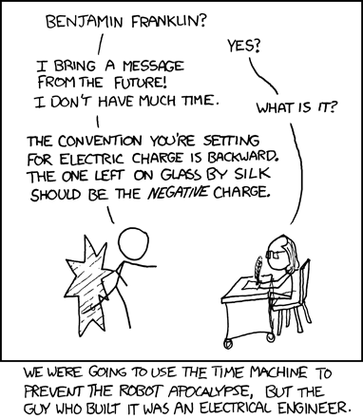

Slide 5
Applying a voltage
When a voltage or potential difference is applied to a wire, an electric field is set up.
The electrons experience an electric force.
F_{E}
A battery (monkey) provides the potential difference (voltage) between the positive and negative terminals.
This electric field causes electrons to move in the direction of the positive terminal thus causing current to flow.

Slide 6
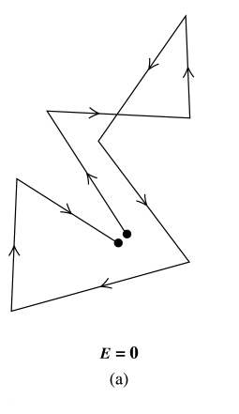
Behaviour of electrons in a wire without a voltage applied
No electric field
Random movements
Brownian Motion

Slide 7
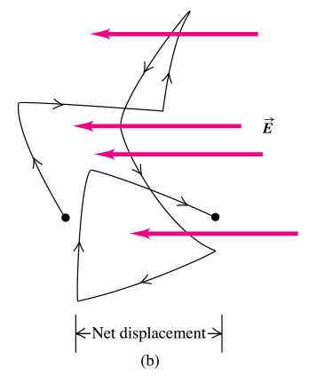
Behaviour of electrons in a wire when a voltage is applied
Movements in the direction opposite
to E
v (velocity) E

Slide 8
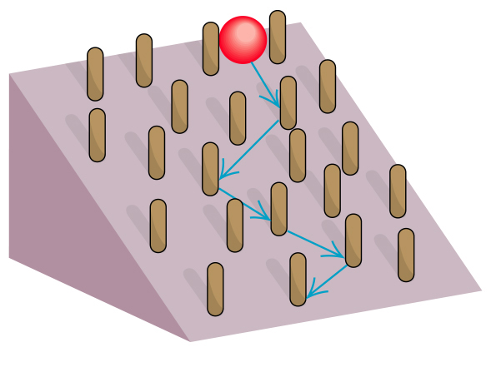
Analogy to the motion of an electron in a metallic conductor
with an electric field present

Slide 9
A section of wire in the red box has been enlarged in the diagrams below.
The switch is open.
The circuit is open so there is no electric field from the battery. Nevertheless the electrons are not stationary, they are “orbiting the nucleus”. The electrons could be going in any direction at any speed at any time. The net result of adding up all the vectors for all the valence electrons is zero. Hence if there is no net electron flow, there is no current.

Slide 10
Switch closed
The electrons are immersed in a uniform electric field supplied by the battery.
The electrons fall through the electric field with a drift velocity of around 2 cms⁻¹ towards the +ve terminal.
The -ve terminal of the battery repels electrons and the +ve terminal attracts electrons.
For electrons to move around a closed circuit a potential difference (pd) or voltage (V) must be applied. When a battery is connected to a closed circuit an electric field is formed which allows the electrons to drift and produce current.

Slide 11
Voltage measures the amount of energy carried by a certain amount of charge
Energy, measured in Joules (J)
Voltage, measured in Volts (V)
Charge, measured in Coulombs (C)

Slide 12
1. A battery supplies 96000 joules of energy to 12000 C of charge. What is the voltage supplied by the battery?
2. A lamp converts 108 kJ of electrical energy to light when 12000 C of charge passes.
What is the voltage across the lamp?
3. A light emitting diode (LED)draws a current of 30mA and the voltage (p.d.) across it is 1.7 V
a) How much charge passes through the LED in 10 seconds ?
b) How much energy (in joules) will be consumed by the led in 10 seconds ?

Slide 13
Resistance
An electron traveling through the wires and components of a circuit will encounter resistance. Resistance is the hindrance to the flow of charge.
The symbol for Resistance is R and the unit is the ohm Ω,
note 1 Ω = 1JsC⁻²
The resistance of a wire is directly proportional to its length and inversely proportional to its cross-sectional area:
A
The constant (ρ), the resistivity,
is characteristic of the material.
L

Slide 15
Smoking is bad!

Slide 17
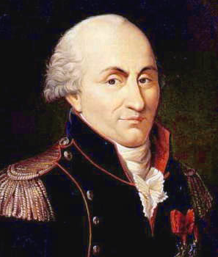
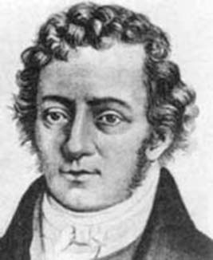
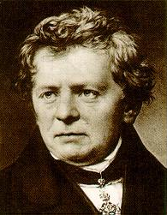
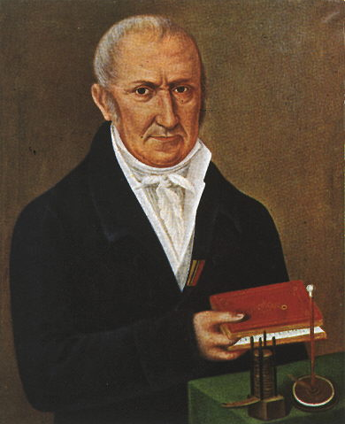
The Examiners' Report
Candidates were confused between current and voltage ...
Some candidates persisted with the idea of current “driving” the electricity rather than using the correct ideas of emf and pd. potential difference (pd), can be potential drop (pd) or potential rise (pr).
Many candidates had an insufficient grasp of the concepts of current and voltage ...
Charles-Augustin de Coulomb
(1736 – 1806)
André Marie Ampère
(1775 – 1836)
George Simon Ohm
(1789 – 1854)
What is:
a coulomb;
an ampere;
an ohm; and
a volt?
Alessandro Giuseppe Antonio Anastasio Volta
1745 - 1827

Slide 18
Explanations
a coulomb.
You should LEARN that:
The COULOMB is a unit of charge made up of a fixed Quantity (number) of electrons.
The charge of one electron is: –1.6 x 10⁻¹⁹ C.
More precisely: –1.602 176 487(40) × 10^{–19} C
The ACTUAL quantity of electrons that makes up the coulomb is the inverse of the charge of one electron.
(1.6 x 10⁻¹⁹)⁻¹ = 6.2 x 10¹⁸ electrons.
Or more precisely 6 241 509 629 152 650 000 electrons.
Charles-Augustin de Coulomb
(1736 – 1806)

Slide 19
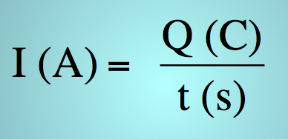
Explanations
André Marie Ampère
(1775 – 1836)
an ampere.
You should LEARN that:
One ampere (A) describes the current flow of one unit of charge (C) passing a point in a circuit in one second (s).
A = C s⁻¹
an ohm.
George Simon Ohm
(1789 – 1854)
You should LEARN that:
The ohm is a measure of the resistance to the flow of current.
The value of resistance determines how well a conductor conducts electricity.
The smaller the number, the better the conductor.
The unit of resistance is the ohm (Ω).
Resistance is proportional to L & 1/A

Slide 20
Explanations
Alessandro Giuseppe Antonio Anastasio Volta
1745 - 1827
a volt.
You should LEARN that:
A volt is the gain or loss of one unit of energy by one unit of charge.
A unit of energy is the joule (J) and a unit of charge is the coulomb (C).
Example
A fully charged 12 V battery has a potential rise (pr) of 12 V.
This means that every unit of charge (C) has gained 12 J of energy since V = J C⁻¹
A potential drop (pd) of 12 V across a resistor means that each unit of charge (C) has lost 12 J of energy since V = J C⁻¹
This energy has been transformed into heat.

