Slide 1
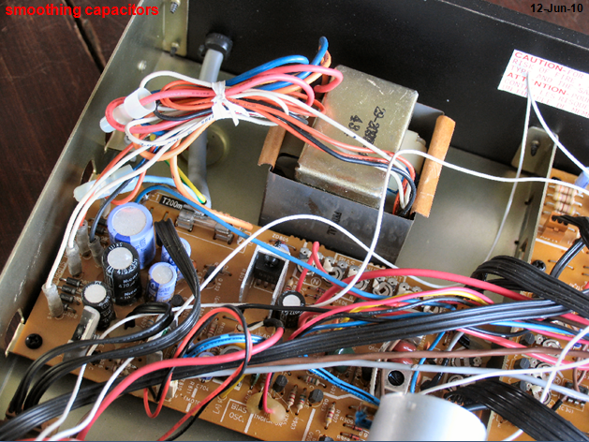

Slide 2
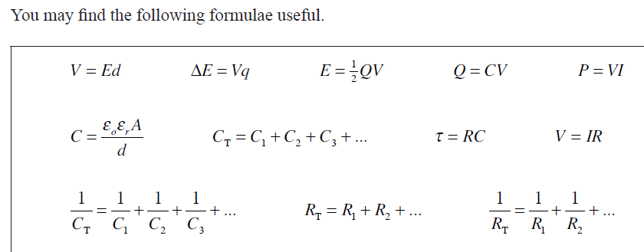

Slide 3
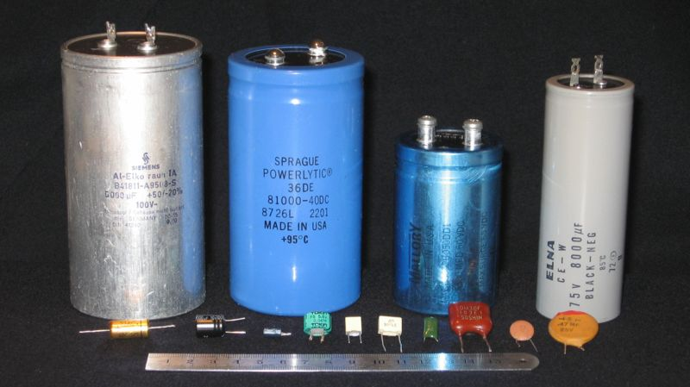

Slide 4
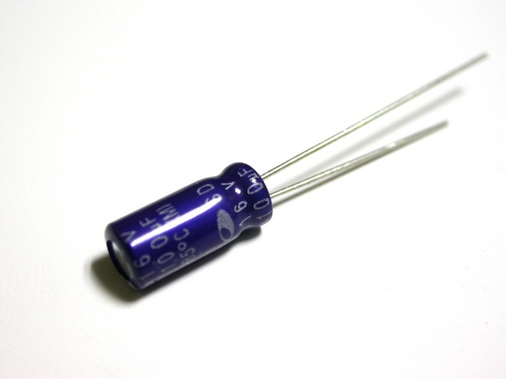
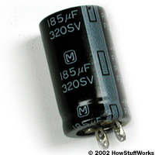
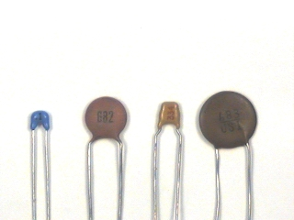
Capacitor
Is a device that stores energy by maintaining a separation between positive and negative charge.
Compare stored energy / charge to a bucket of water which can be filled and emptied.
Consists of two conductors (metal) separated by an insulator.
Capacitors have many applications:
Computer keyboards
Electronic flashes for cameras
Electric power surge protectors
Radios and electronic circuits
(Symbol: )

Slide 5
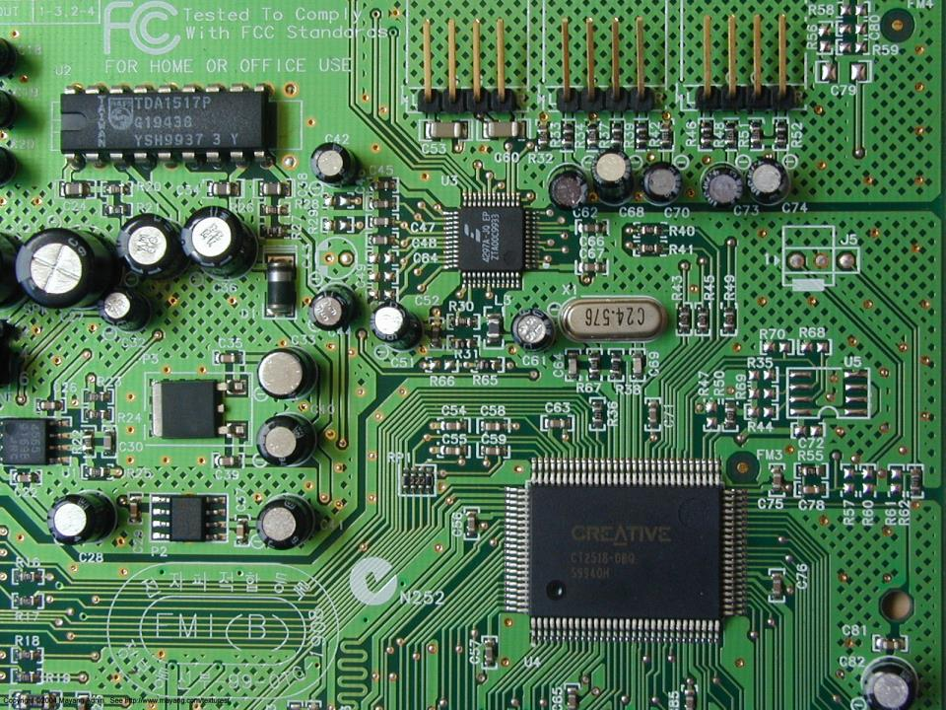

Slide 6
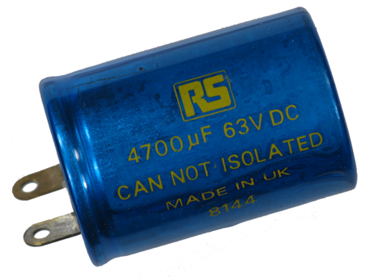
capacitors

Slide 7
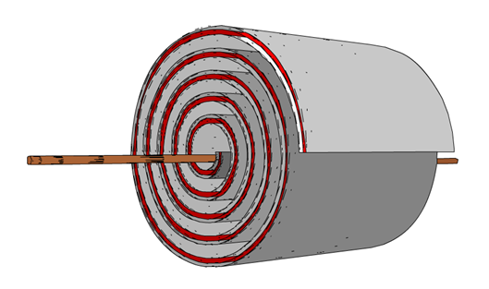

Slide 8
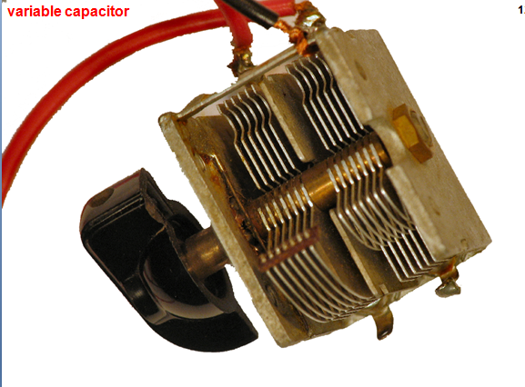

Slide 9
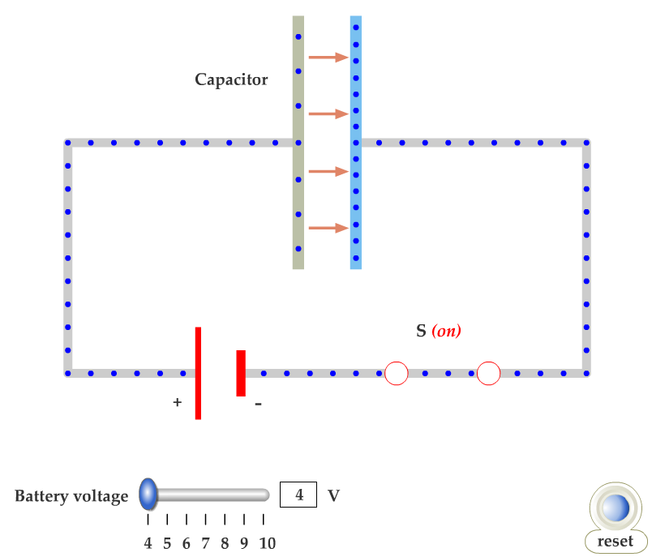

Slide 11
Q and V are proportional:
Q = C V
C = Capacitance
(a fixed property of each capacitor)

Slide 12
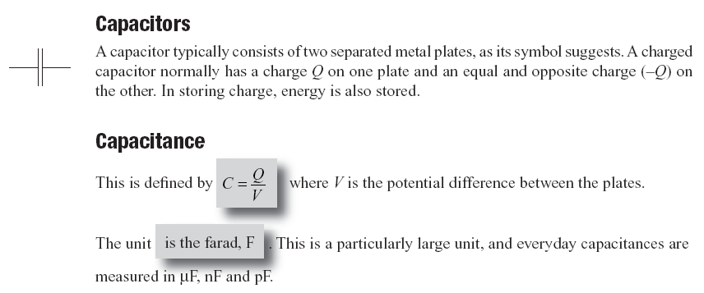
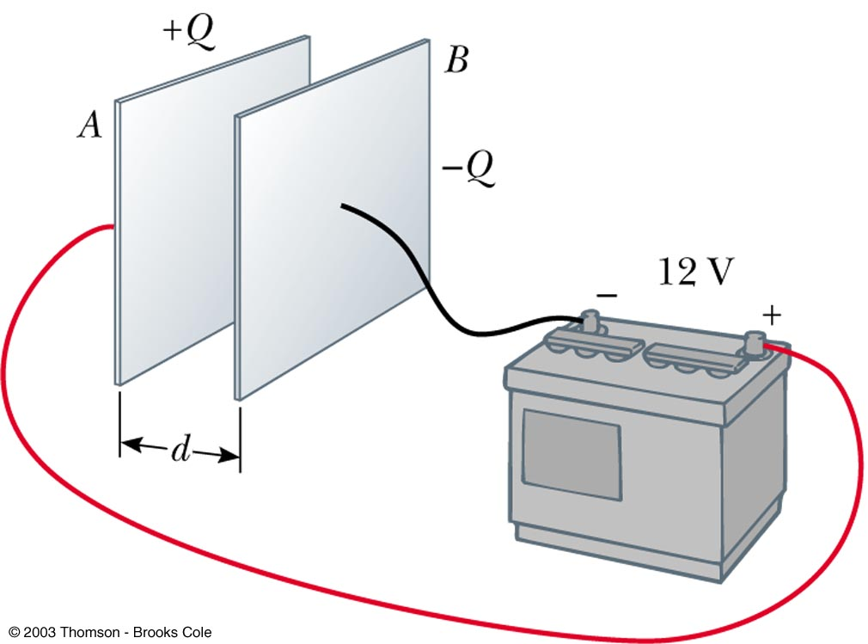
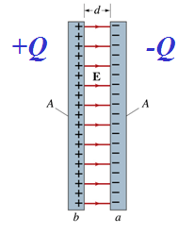
SI unit = 1 Farad (F)
i.e. 3μF = 3*10-6 F
When the capacitor is fully charged:
the current flow stops
both plates have an equal and opposite amount of charge Q
the pd across the plates, V = the supply voltage
a uniform electric field exists between the plates

Slide 13
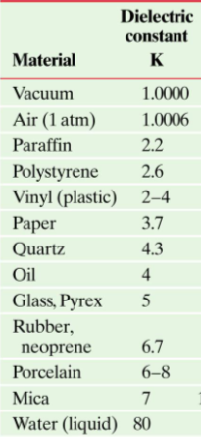
The capacitance of a parallel capacitor depends on 3 factors
1) A = plate area
C ∝ A
2) d = plate separation
C ∝ 1/d
A
d
(ε₀= 8.85 x 10⁻¹² C²/Nm²)
ε_{o} is the absolute permittivity of free space
3) Adding a dielectric
ε_{r} = dielectric constant
Adding a dielectric increases the Capacitance

Slide 14
17.8 Dielectrics
The molecules in a dielectric tend to become oriented in a way that reduces the external field.
The dielectric blocks some of the electric field lines, so the voltage decreases. Since Q=CV, if V decreases, C increases. Q must stay constant because the capacitor is not connected to a voltage source.

Slide 15
17.8 Dielectrics
This means that the electric field within the dielectric is less than it would be in air, allowing more charge to be stored for the same potential.

Slide 16
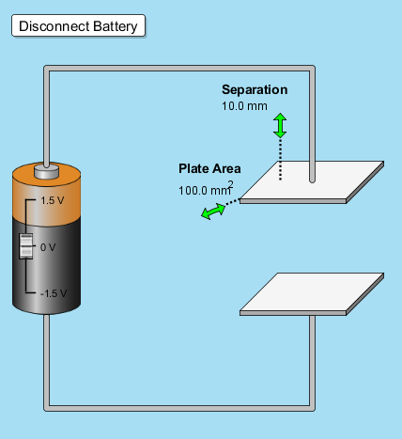
Determine C

Slide 17
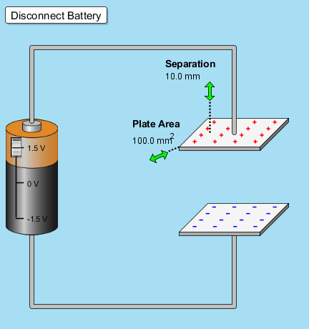
Determine Q

Slide 18
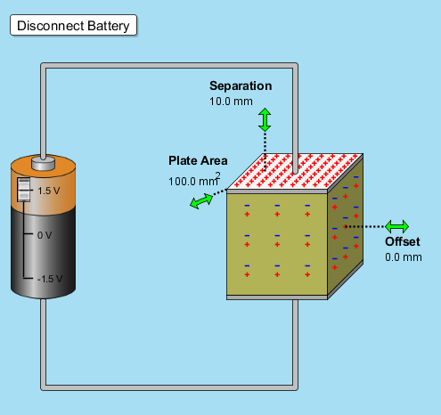
Determine C & V
with ε_{r} = 5.0

Slide 19
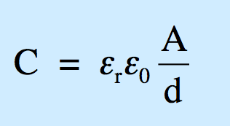
Capacitors
Show the area of the capacitor plate is 48 μm²; and
determine the value of the capacitor.
A porcelain dielectric is placed between the plates.
What is the value of the new capacitance?
12 mm
distance | metres
cm | 1 x 10⁻²
mm | 1 x 10⁻³
µm | 1 x 10⁻⁶
nm | 1 x 10⁻⁹
pm | 1 x 10⁻¹²
4.0 mm
100 μm
DIELECTRIC CONSTANT OF MATERIALS
Air | 1.00 | Cellulose | 3.70 | Glass | 7.75
Teflon | 2.10 | Fiber | 6.00 | Mica | 5.40
Paper | 3.00 | Porcelain | 5.57 | Quartz | 3.80

Slide 20
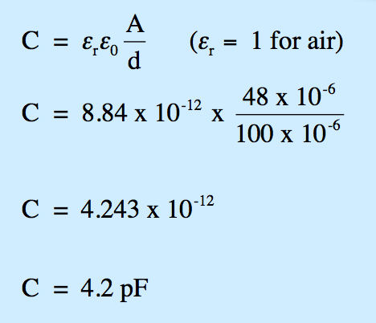
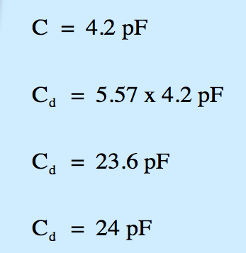
Capacitors
Show the area of the capacitor plate is 48 μm².
determine the value of the capacitor.
12 mm
A porcelain dielectric is placed between the plates.
What is the value of the new capacitance (C_{d})?
4.0 mm
A
100 μm
M
M

Slide 21
