Slide 1
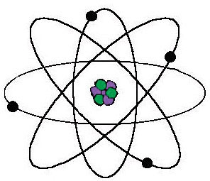
Atomic Structure
Electrons
Tiny, very light particles
Have a negative electrical charge (-)
Move around the outside of the nucleus
Protons
Much larger and heavier than electrons
Protons have a positive charge (+)
Located in the nucleus of the atom
Rutherford’s MODEL of the Atom
Neutrons
Large and heavy like protons
Neutrons have no electrical charge
Located in the nucleus of the atom
A dense, positively charged nucleus
Negatively charged electrons orbiting the nucleus.
Nuclear Symbols
Element symbol
Mass number (A)
(number of p⁺ + nº)
Atomic number (Z)
(number of p⁺)

Slide 2
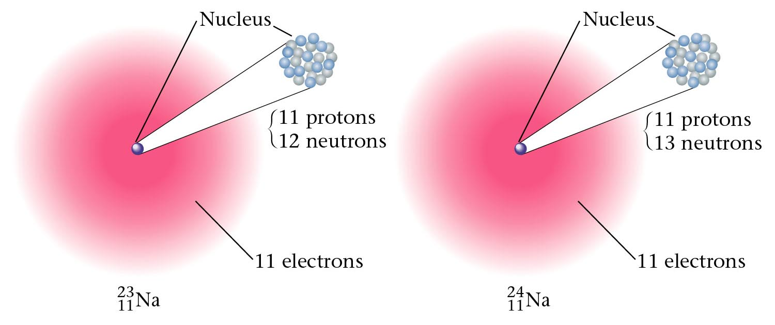
Atoms of each element have a specific number of proton, but can have varying # of neutrons
Atoms with the same number of protons but different numbers of neutrons are called isotopes, ie same Atomic # but different mass #.
A nuclide refers to a specific isotope of an element.
eg Isotopes of Hydrogen
Hydrogen (1 proton)
Deuterium
Tritium
¹H₁
²H₁
³H₁
eg two isotopes of sodium

Slide 3
Example – Hydrogen Isotopes
1
H
Hydrogen
1 proton and 0 neutron in the nucleus.
p
1
2
H
Deuterium
1 proton and 1 neutron in the nucleus.
n
1
p
3
H
Tritium
1 proton and 2 neutrons in the nucleus.
n
n
p
1

Slide 4
