Slide 1
AC Circuits
What’s it all about???
Year 12 Math, Pythagoras,
Phasors & Sine curves
Note: L3 is only a tiddly bit / taste…

Slide 2
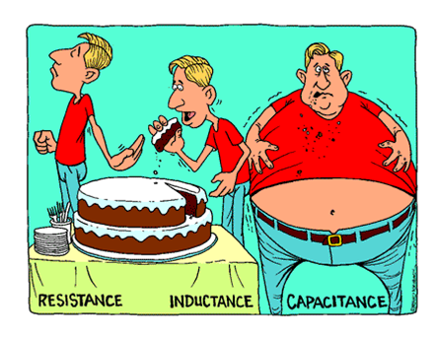

Slide 3
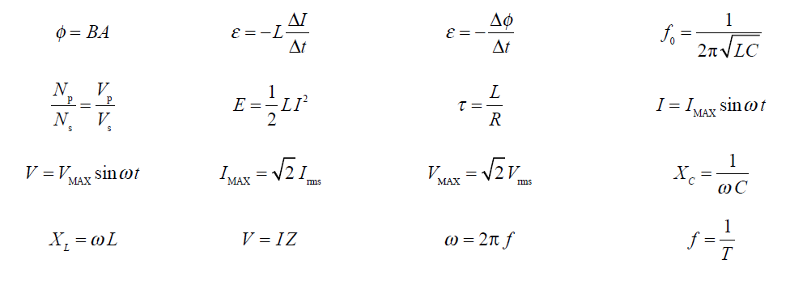

Slide 4
Generating AC voltage
A loop rotating in a magnetic field with constant angular velocity ω, has a sinusoidal voltage induced in it.
Magnitude is V=V_{max}sinωt
where ω=2πf (angular speed of the rotating coil, rad s⁻¹)
ω
B

Slide 5
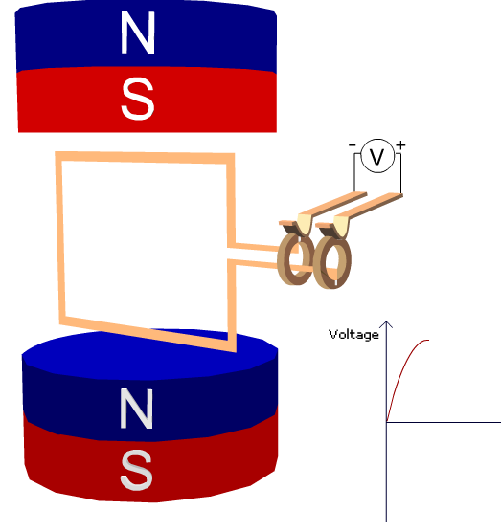
Φ = B A cosθ
θ = angle between B and Normal to the surface area ie max Φ when coil perpendicular to B
Zero Φ
max V output
‘Clockwise’
Notes:
See 1 AC motor applet

Slide 6
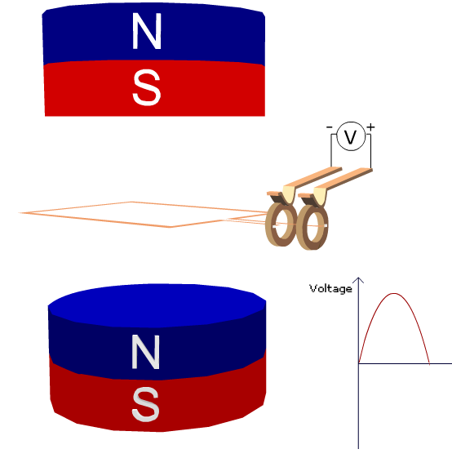
Max Φ
zero V output

Slide 7
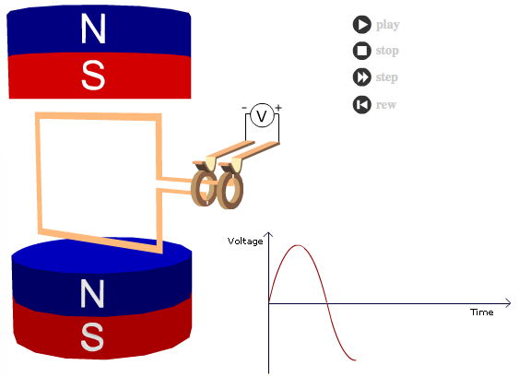
Transformers PTRB.mp4
Zero Φ
max V output
‘anti-clockwise’

Slide 8
AC in a resistor
Ohms Law holds at any point in time.
V_{m}sinωt
I
V_{m}= V_{max}
I= I_{max}
R
V and I may be shown as functions of time as below. Both current and voltage are said to be IN PHASE
V_{max}
V_{m}
V
I_{max}
I
ω
(2πf)
Phasor Diagram (?)

Slide 9
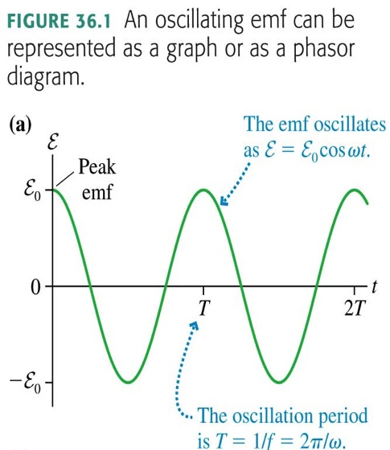
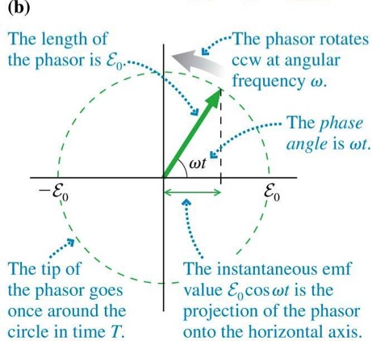

Slide 10
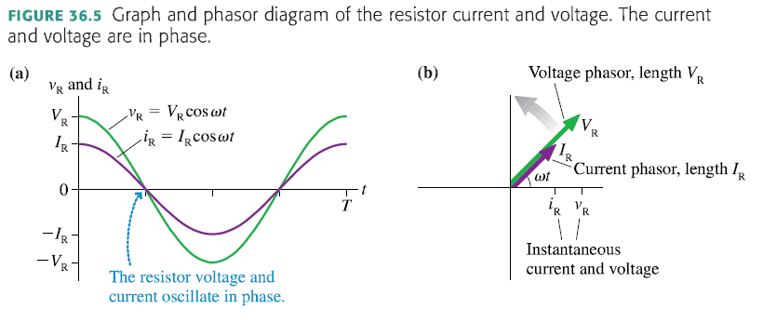

Slide 11
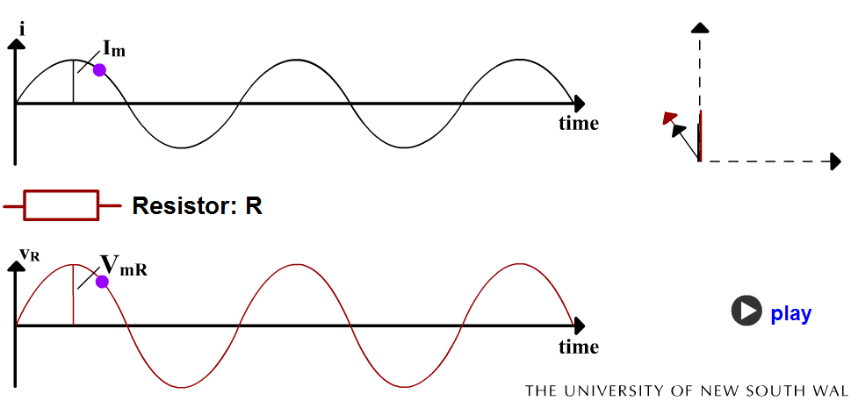
2 R & I Phasors Applet

Slide 12
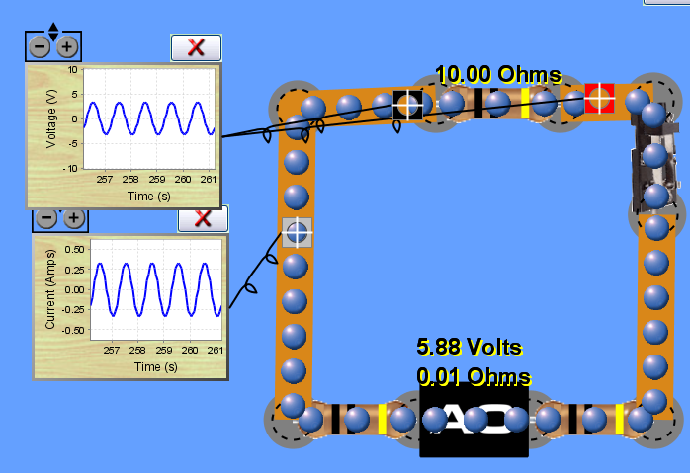

Slide 13
How to measure AC?
rms ????
Root mean square…
Unless stated all AC voltage & current values are rms values

Slide 14
How to measure AC?
An AC power supply with a maximum voltage of 10V and a frequency of 0.025Hz was connected to a 10Ω resistor as shown
As AC is constantly changing we need to use an average value to be able to compare an AC supply to a DC supply.
10 V f = 0.025Hz
I
V
10 Ω
Time (s) | 0 | 5 | 10 | 15 | 20 | 25 | 30 | 35 | 40 | Ave
Voltage (V) | 0 | 7.1 | 10 | 7.1 | 0 | -7.1 | -10 | -7.1 | 0 | 0
Current (A) | 0 | 0.71 | 1.0 | 0.71 | 0 | -0.71 | -1.0 | -0.71 | 0 | 0
Power (W) | 0 | 5.0 | 10 | 5.0 | 0 | 5.0 | 10 | 5.0 | 0 | 5.0
Average V and I are = 0
Average power is half the maximum power
As the maximum voltage and current only happen for an instant we need a more meaningful description ~ Use RMS values (root mean square)

Slide 15
Graph of Power output vs Time
I²R
Max Output
Average Output
t
P = VI (no direction – scalar)
P = V_{m} sinωt x I_{m} sinωt
P = (VI)_{m}sin²ωt - gives M shape trig graphs

Slide 16
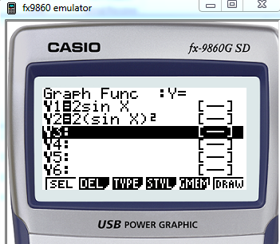
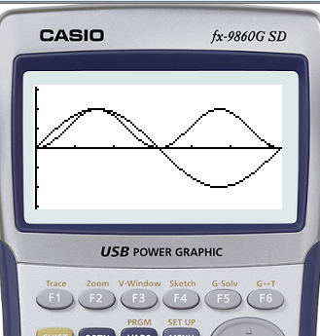

Slide 17
RMS (root mean square) I_{rms} V_{rms}
The rms value of AC voltage or current is the DC value which produces the same average power output.
I
V_{m}sinωt
V_{rms}
I_{rms}
I²R
R
R
I_{rms}²R
t
t
Hence:
It follows that:
Unless stated all AC voltage & current values are rms values

Slide 18
How to state an AC value?
use RMS (root mean square)
The rms value of AC voltage or current is the DC value which produces the same average power output.
Power
I²R
I_{rms}²R
t
t

Slide 19
Don’t Stress
Just use a formula…

Slide 20
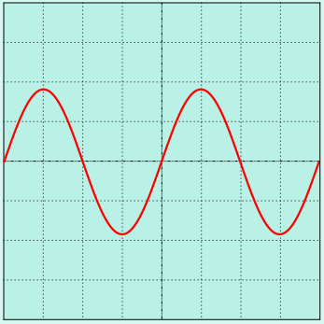
AC circuits
This diagram shows the display of an oscilloscope that is connected in parallel to a lamp.
Determine the following
Period
Frequency
Peak to peak voltage
Maximum voltage
RMS voltage
OSC
Y - gain setting 10 V cm⁻¹
The working resistance of the lamp is 6 Ω
Calculate
Maximum current
RMS current
Peak power
RMS power
Time base 5 ms cm⁻¹

Slide 21
AC circuits
This diagram shows the display of an oscilloscope that is connected in parallel to a lamp.
Answers to the following
1. Period T = 20 ms
2. Frequency f = 50 s⁻¹ (Hz)
OSC
3 Peak to peak voltage = 36 V
4. Maximum voltage = 18 V
5. RMS voltage = 13 V
T
The working resistance of the lamp is 6 Ω
Calculate
Maximum current = 3 A
RMS current = 2 A
Peak power = 54 W
RMS power = 27 W
Y - gain setting 10 V cm⁻¹
T
5 correct : Achieved
Time base 5 ms cm⁻¹

Slide 22
AC circuits
This diagram shows two cycles of a sine wave representing the peak voltage across a 10 Ω lamp. The peak voltage is 14 V
14 V
Sketch this diagram in your notes.
Superimpose on your sketch the current going through the 10 Ω lamp.
Superimpose on your sketch the peak power used by the lamp.
Draw a line on your sketch to represent the RMS value of:
a) of the volts,
b) the current and
c) the power
time
-14 V

Slide 23
AC circuits
This diagram shows two cycles of a sine wave representing the peak voltage across a 10 Ω lamp. The peak voltage is 14 V
Volts
14 V
Superimpose on your sketch the current going through the 10 Ω lamp.
2. Superimpose on your sketch the peak power used by the lamp.
3. Draw a line on your sketch to represent the RMS value of:
a) of the volts,
b) the current and
c) the power
Volts
-14 V

